Slide 1

Agile Quality Best Practices
Uttam Bhatta
Kickoff Presentation
June 2019
Agile Transformation
Scrum
Definition of Ready & Done
Roles, Artifacts, Events
Agile Release Train
Quality
DevOps
Implementation Plan
Call to Action
John Blanco — Enterprise Agile Transformation Leader
Kony Agile Quality Portal

Slide 2
Agile Mindset “Agile is a growth mindset. It’s a way of working grounded in a culture of learning.” - Ahmed Sidky (Aka Dr. Agile)

Slide 3
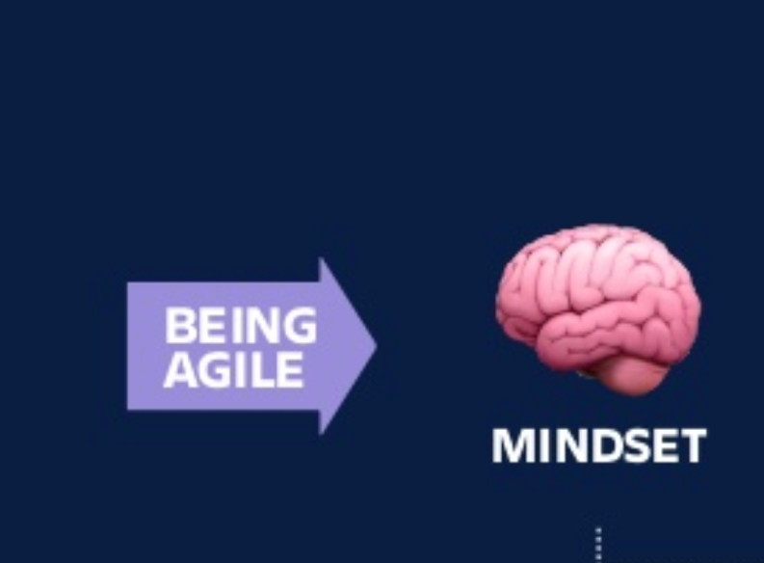
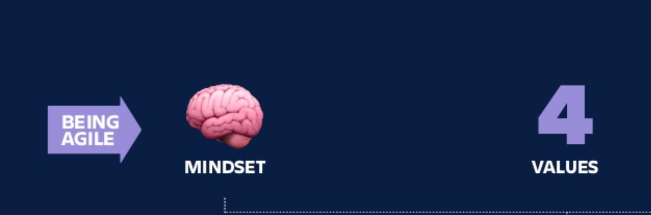
Transparency
Inspection
Adaptation
Individuals and Interactions
over Processes and Tools
Working Software
over Comprehensive Documentation
Customer Collaboration
over Contract Negotiation
Responding to Change
over Following a Predefined Plan

Slide 4
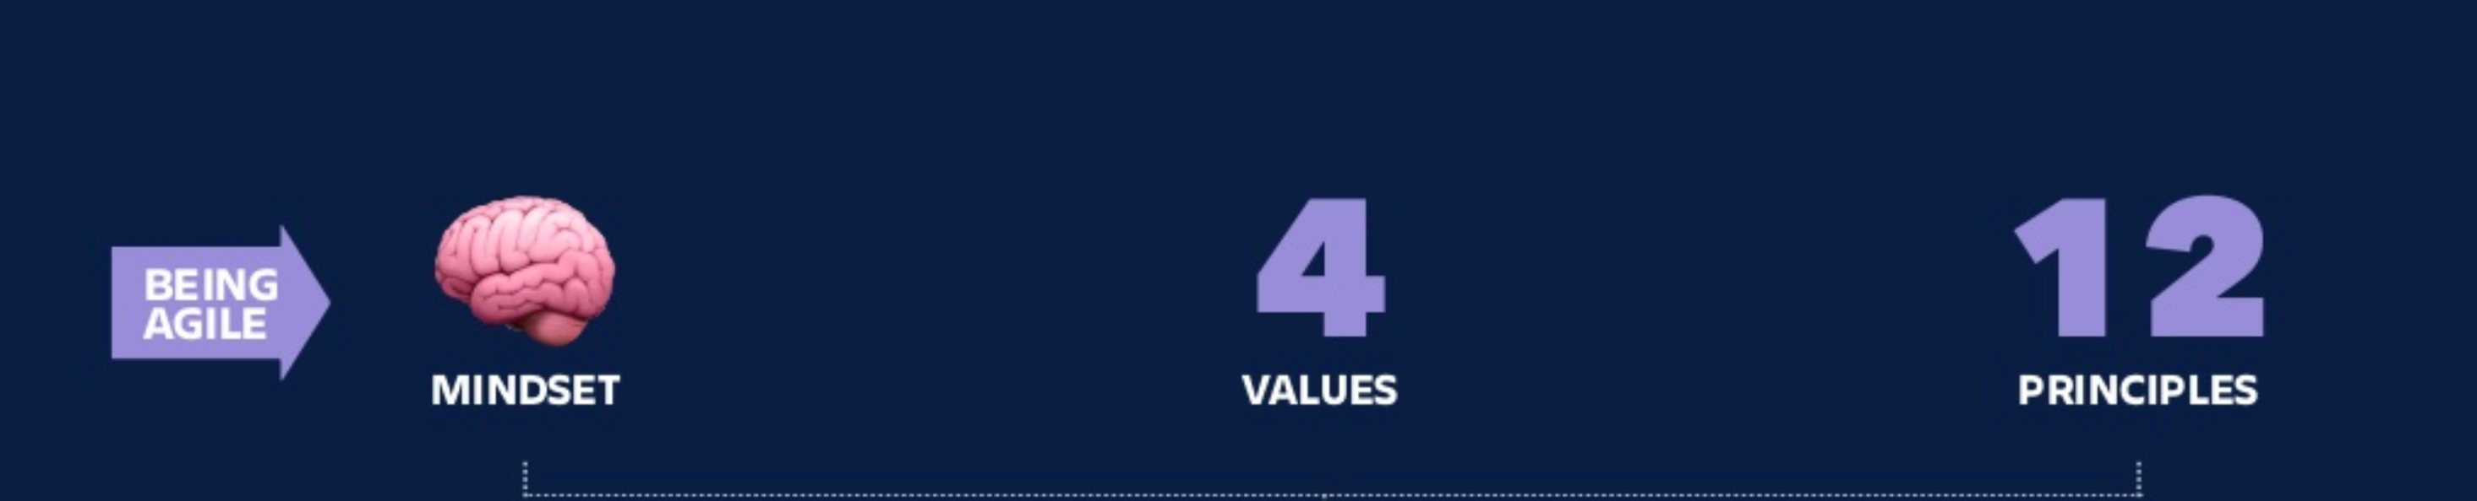
Working Software
Constant Pace (Flow)
Technical Excellence
Simplicity
Self Organized
Reflect and Adjust
Prioritize Customer Satisfaction
Welcome Change
Deliver Frequently
Work Together (as a Team)
Motivate and Trust Teams
Face-to-Face (direct engagement)

Slide 5
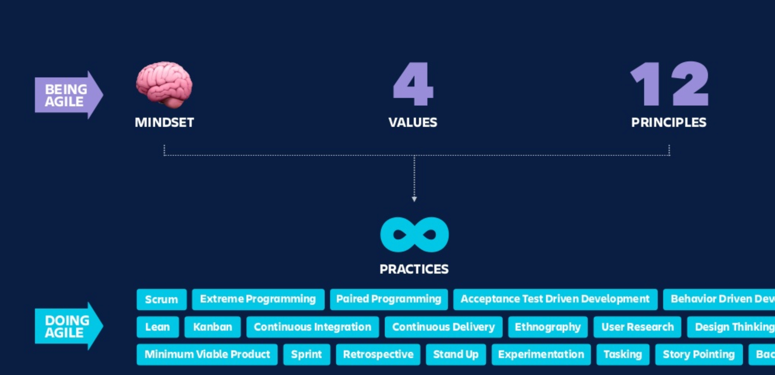

Slide 6
Benefits

Slide 7
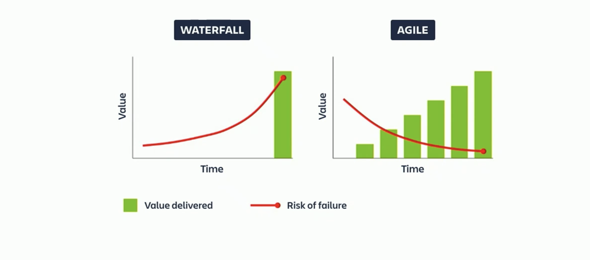
Incremental execution and delivery reduces risk

Slide 8
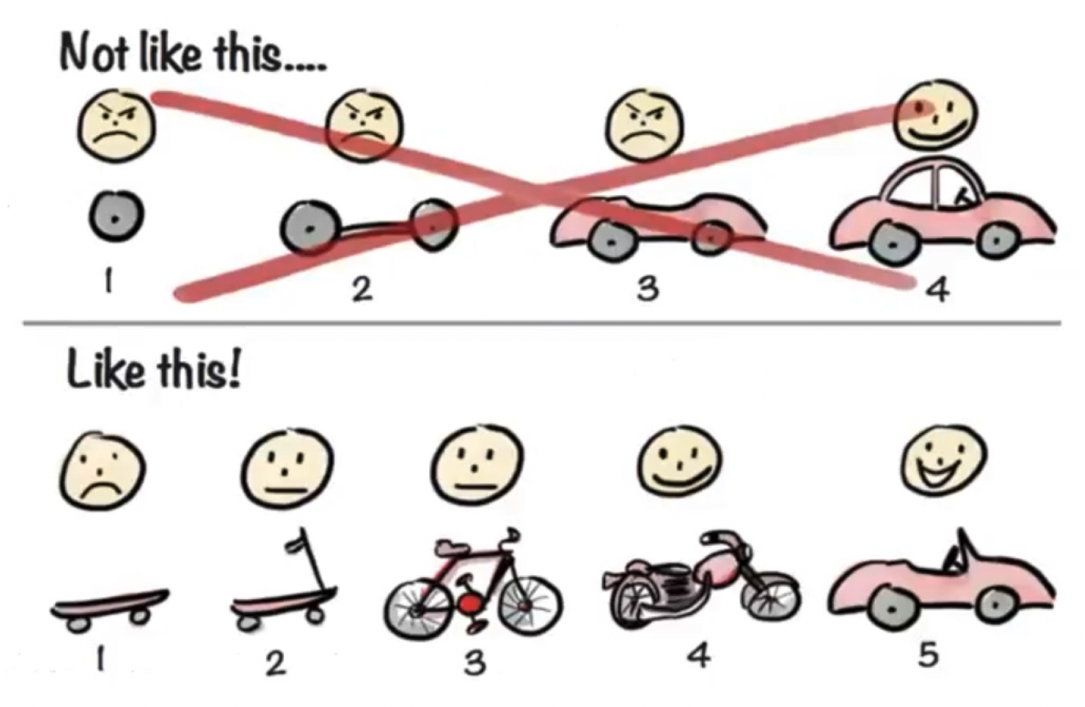
Iterative Design

Slide 9
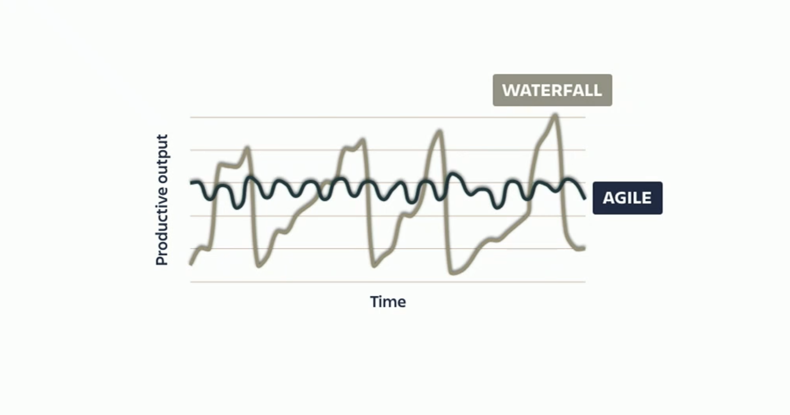
Consistent flow increases efficiency

Slide 10
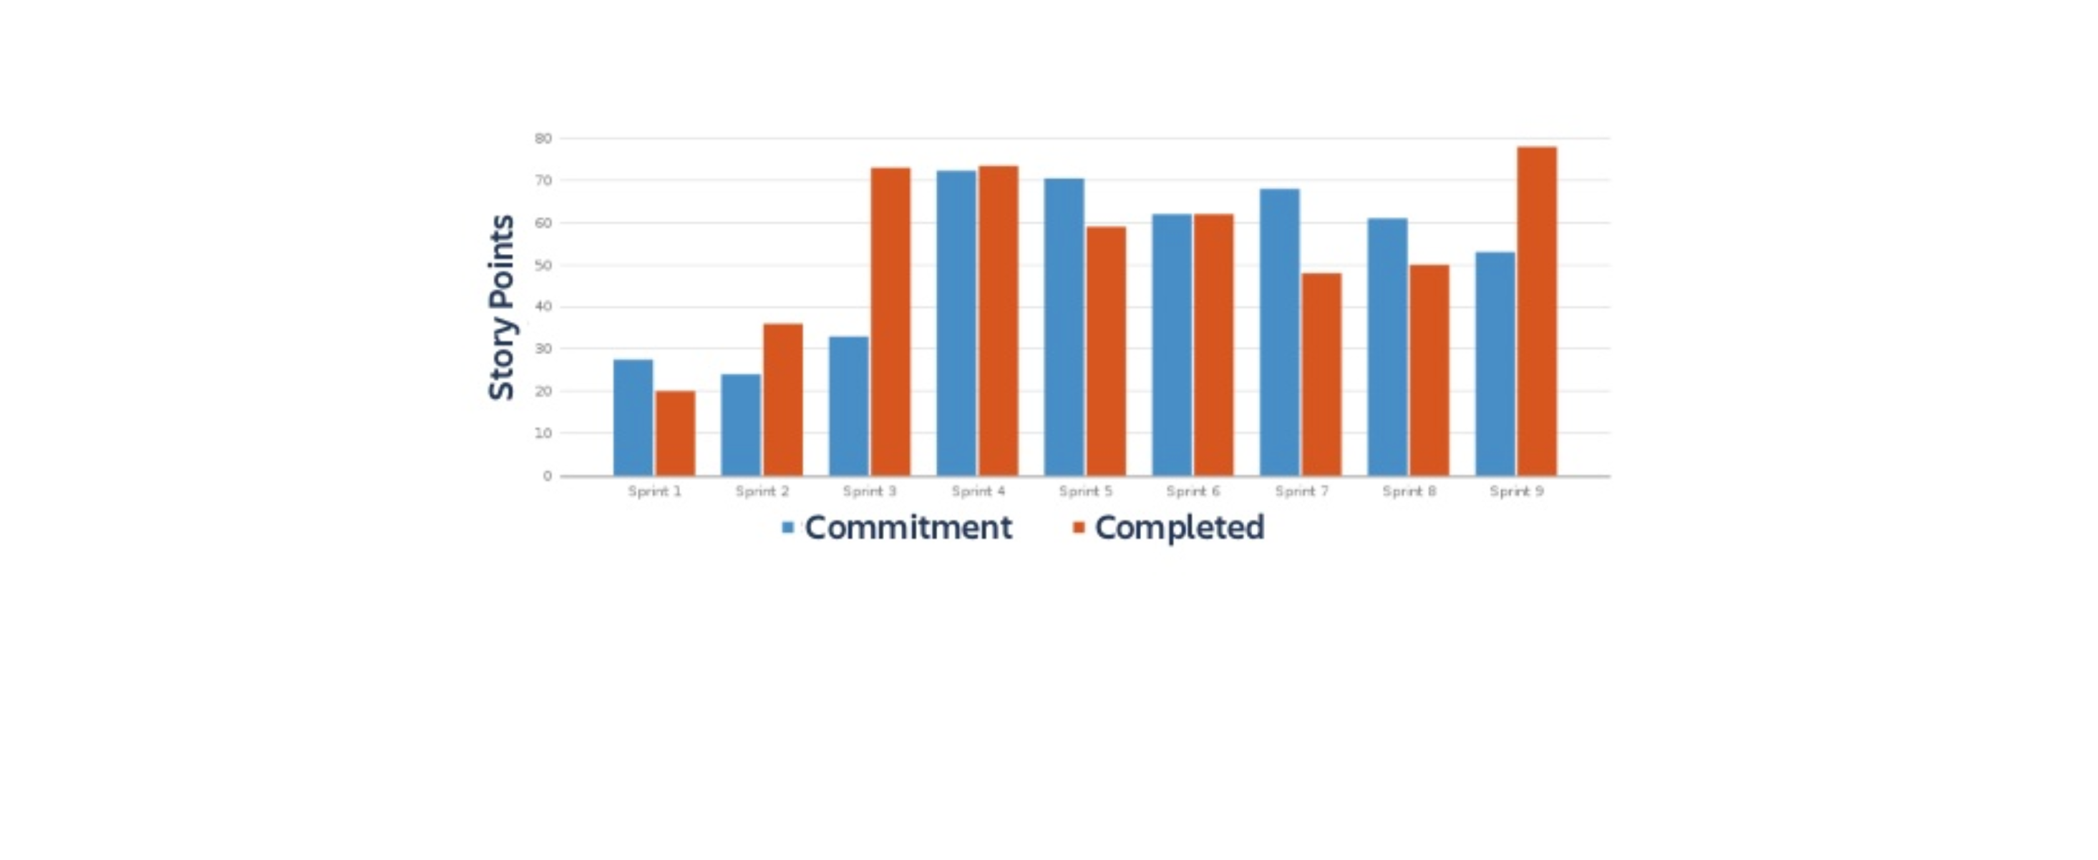
Practiced Estimation increases predictability

Slide 11
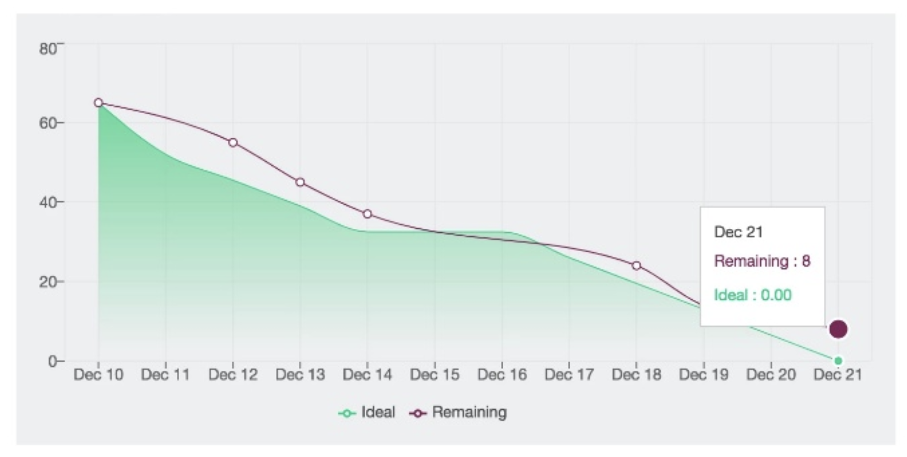
Team laser focused on completed work planned for sprint
HIDDEN SLIDE

Slide 12
Challenges

Slide 13
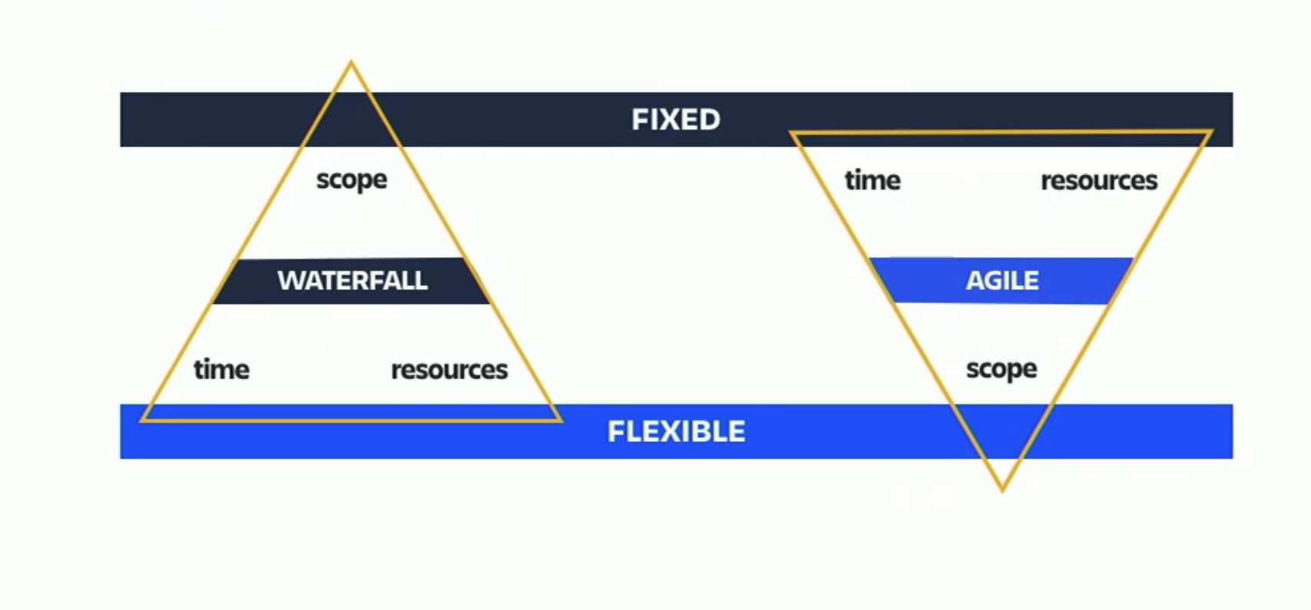
Move from Waterfall to Agile inverts Constraints

Slide 14
Top-down transformation will fail… so will bottoms-up
HIDDEN SLIDE
COMMAND AND
CONTROL
Team Resistance
Just adds work
No buy-in
Loss of control
Limited visibility
Why are we making this investment?
GRASS ROOTS

Slide 15
Define shared objectives, empower teams to achieve them
STRATEGY, GOALS & PRIORITIES
Portfolio
Product
Team
PREDICITIBILTY, TRANSPARENCY & RESULTS

Slide 16
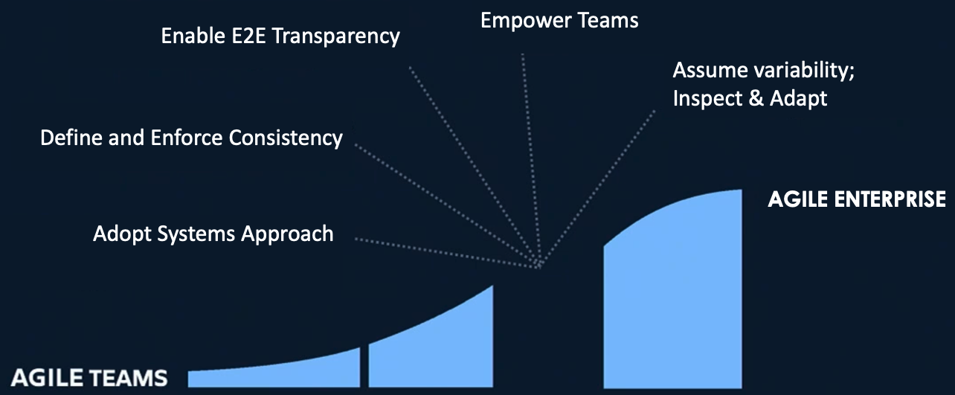
Define the Guiding Vision
Informed by Scaled Agile Framework for Lean Enterprise (SAFe)

Slide 17
Scrum “How fast can I change course in response to new information that contradicts my prior beliefs.“

Slide 18

Ad hoc Agile = “FrAgile”
Didn’t deliver on commitments
Unsustainable pace of work
Useless estimates
Meetings without value
Stalled work mid-sprint
Individuals, rather than a team

Slide 19
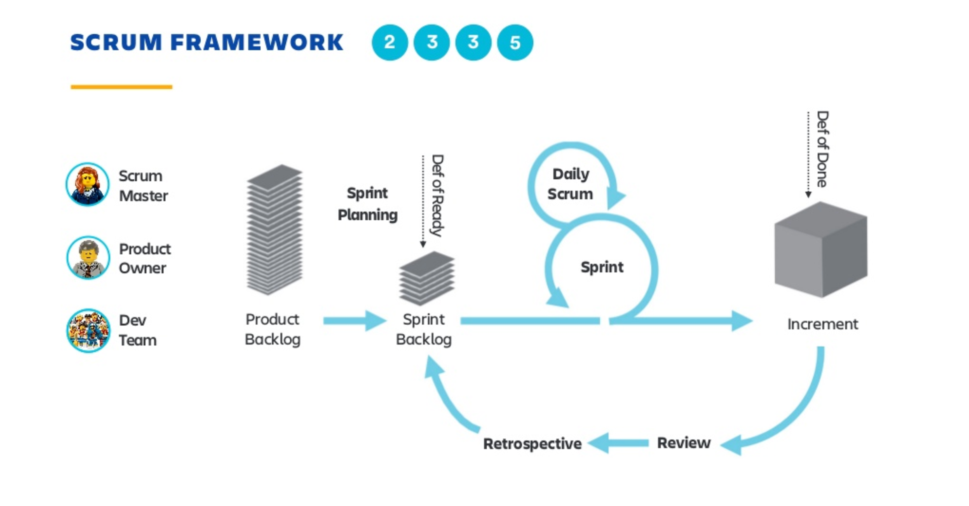

Slide 20
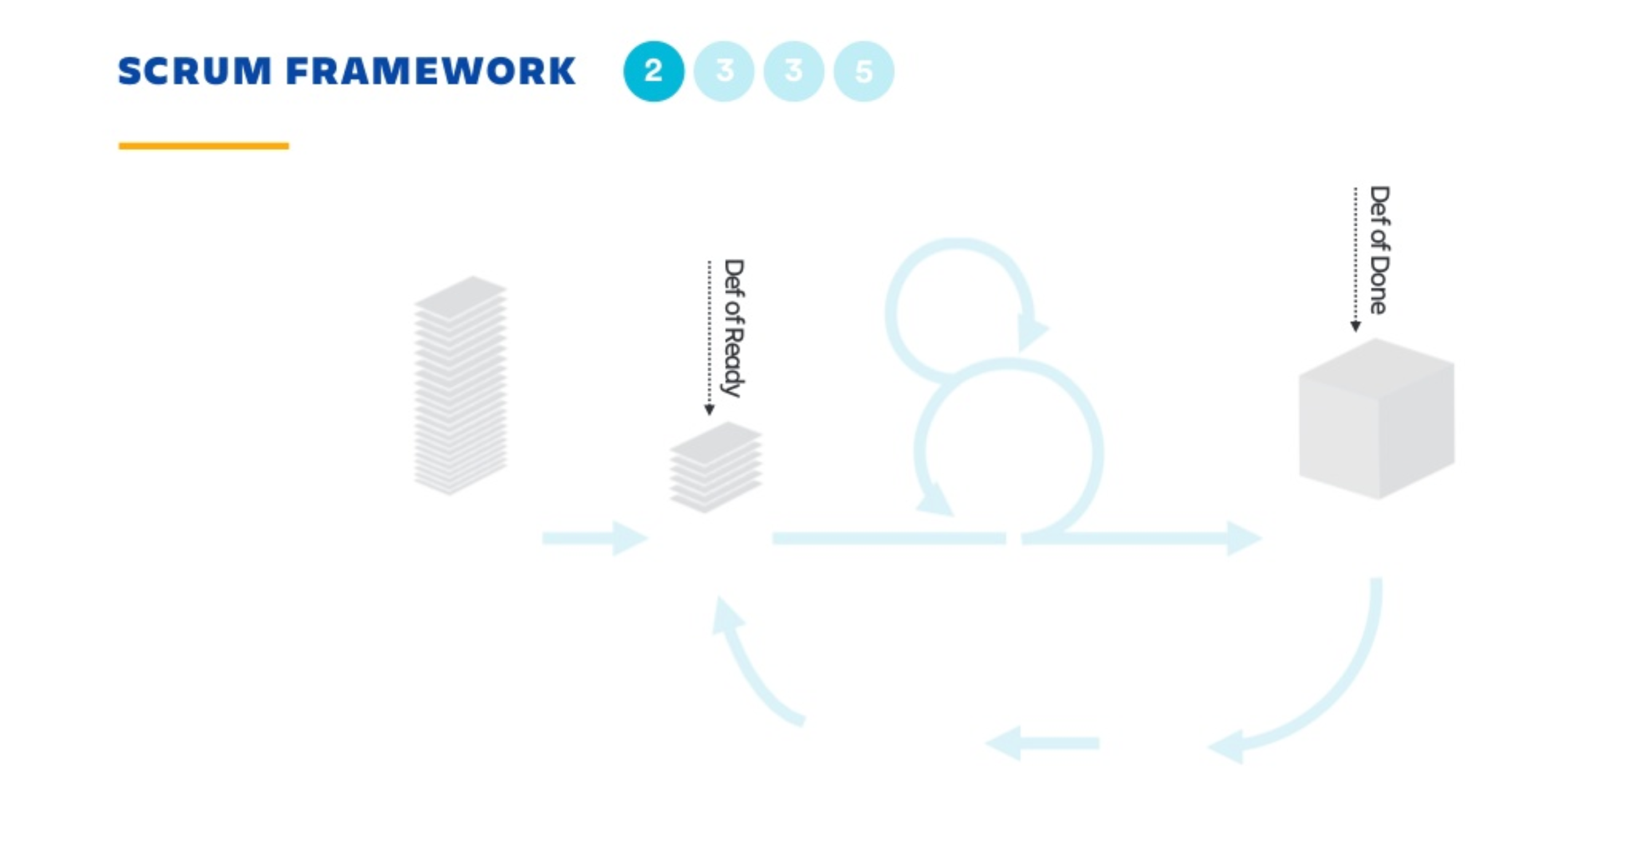

Slide 21
User Story/Epic status definitions
Detailed User Story Written
All feature scenarios and flows (positive and negative) are clearly understood.
The Feature Acceptance criteria is clearly defined and understood.
All relevant non functional requirements are documented and signed off
User story estimation done by team
Designs defined
UX- Feature UX is fully ready and ready for development for all channels in scope
Technical design
Threat modelling Completed
All open questions answered
Acceptance Criteria clearly defined and agreed upon by team
Code Review Completed
Unit testing completed
Passed functionality tests
All must-fix defects resolved (BCH)
All issues marked done
Feature available in nightly CI build and deployed to the QA environment
Product Owner Acceptance
Ready for quality audit
Feature overview (PM) and implementation extension (Engg.) is documented and handed over to the Doc team
[Add] Updates to incl. automation in future
Notes:
(DoR)
User Story is clear
User Story is testable
User Story is feasible
User Story defined
User Story Acceptance Criteria defined
User Story dependencies identified
User Story sized by Development Team
Scrum Team accepts User Experience artefacts
Performance criteria identified, where appropriate
Scalability criteria identified, where appropriate
Security criteria identified, where appropriate
Person who will accept the User Story is identified
Team has a good idea what it will mean to Demo the User Story
(DoD)
Code produced (all ‘to do’ items in code completed)
Code commented, checked in and run against current version in source control
Peer reviewed (or produced with pair programming) and meeting development standards
Builds without errors
Unit tests written and passing
Deployed to system test environment and passed system tests
Passed UAT (User Acceptance Testing) and signed off as meeting requirements
Any build / deployment / configuration changes are implemented / documented / communicated
Relevant documentation / diagrams produced and / or updated
Remaining hours for task set to zero and task closed

Slide 22
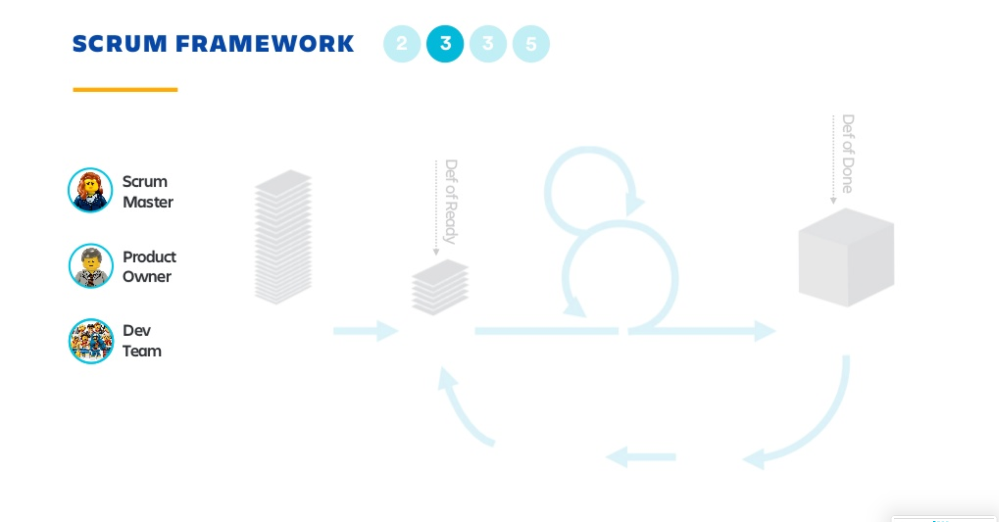

Slide 23
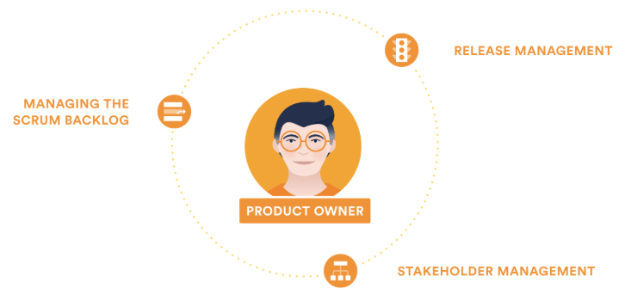


Product Owner
Define the roadmap
Define the features of the product
Decide on release date and content
Prioritize features according to market and business requirements
Adjust features and priority every iteration, as needed
Accept or reject work results
Product Owner Cheat Sheet.pdf

Slide 24
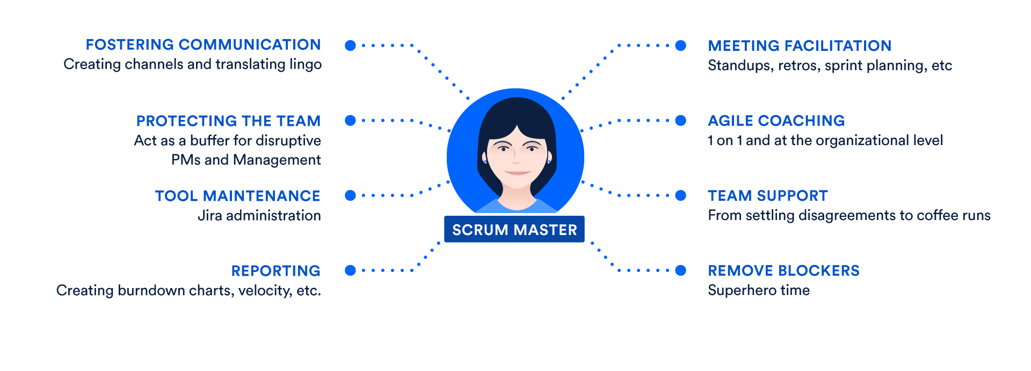
Scrum Master
Scrum Master Cheat Sheet.pdf

Slide 25
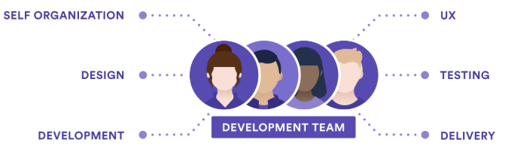
Team Members
Team
Team Member Cheat Sheet.pdf

Slide 26
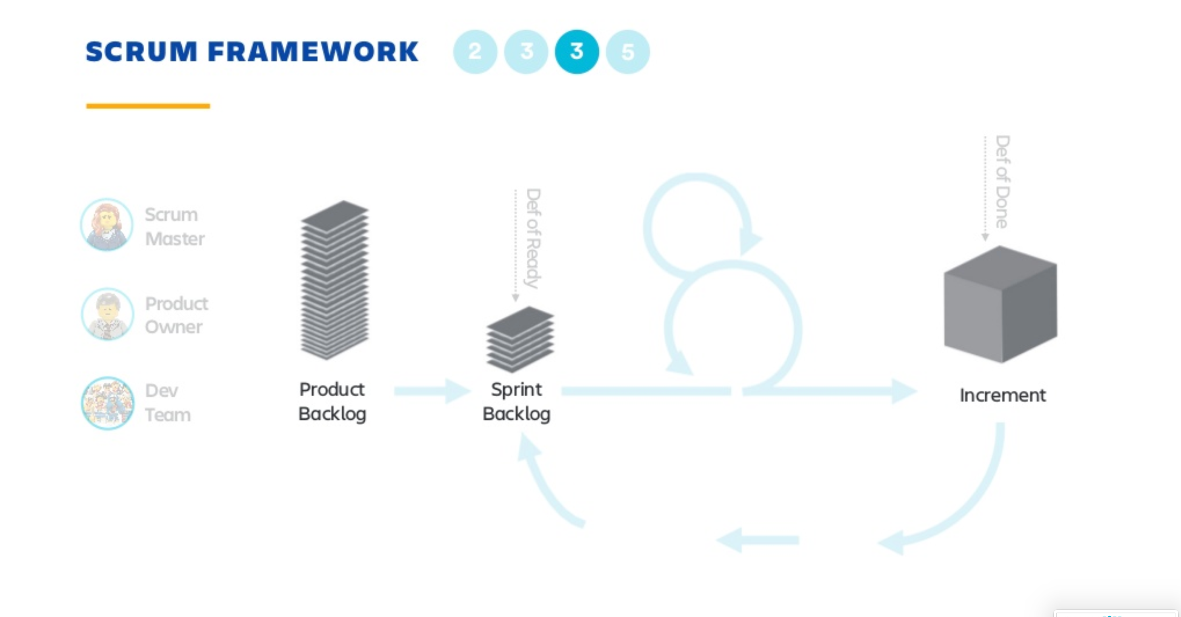

Slide 27
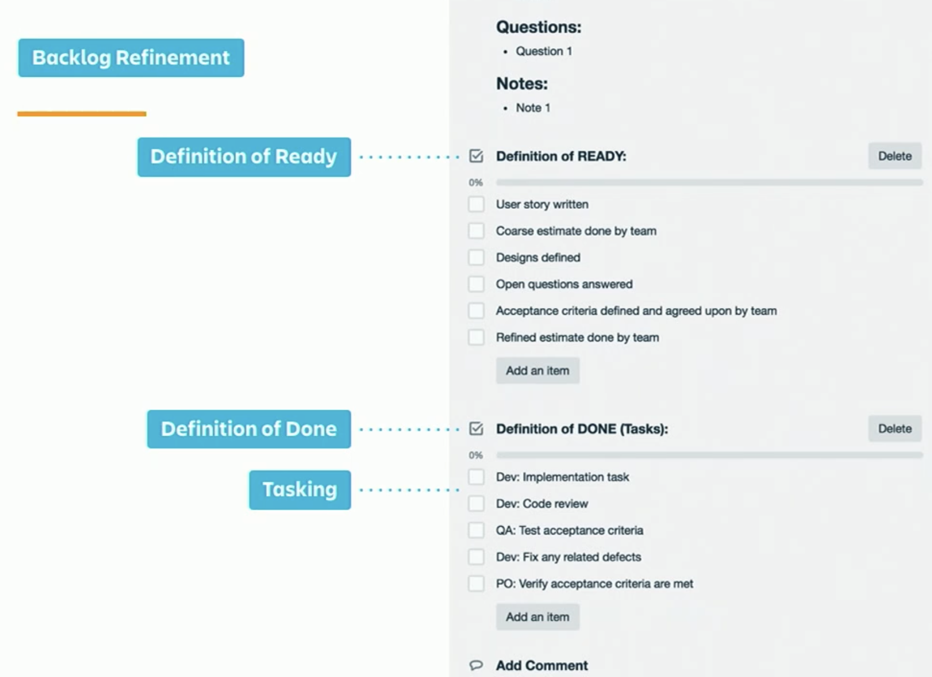
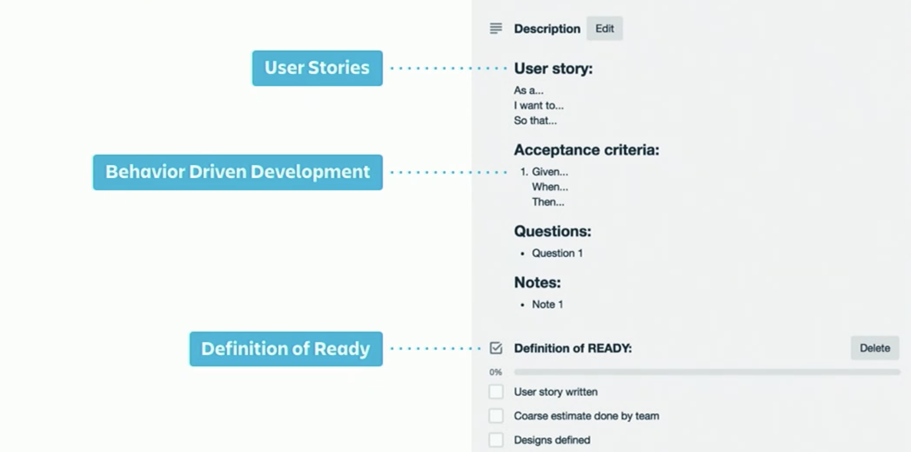
Backlog Grooming - Epics & Stories
HIDDEN SLIDE
Acceptance Criteria

Slide 28
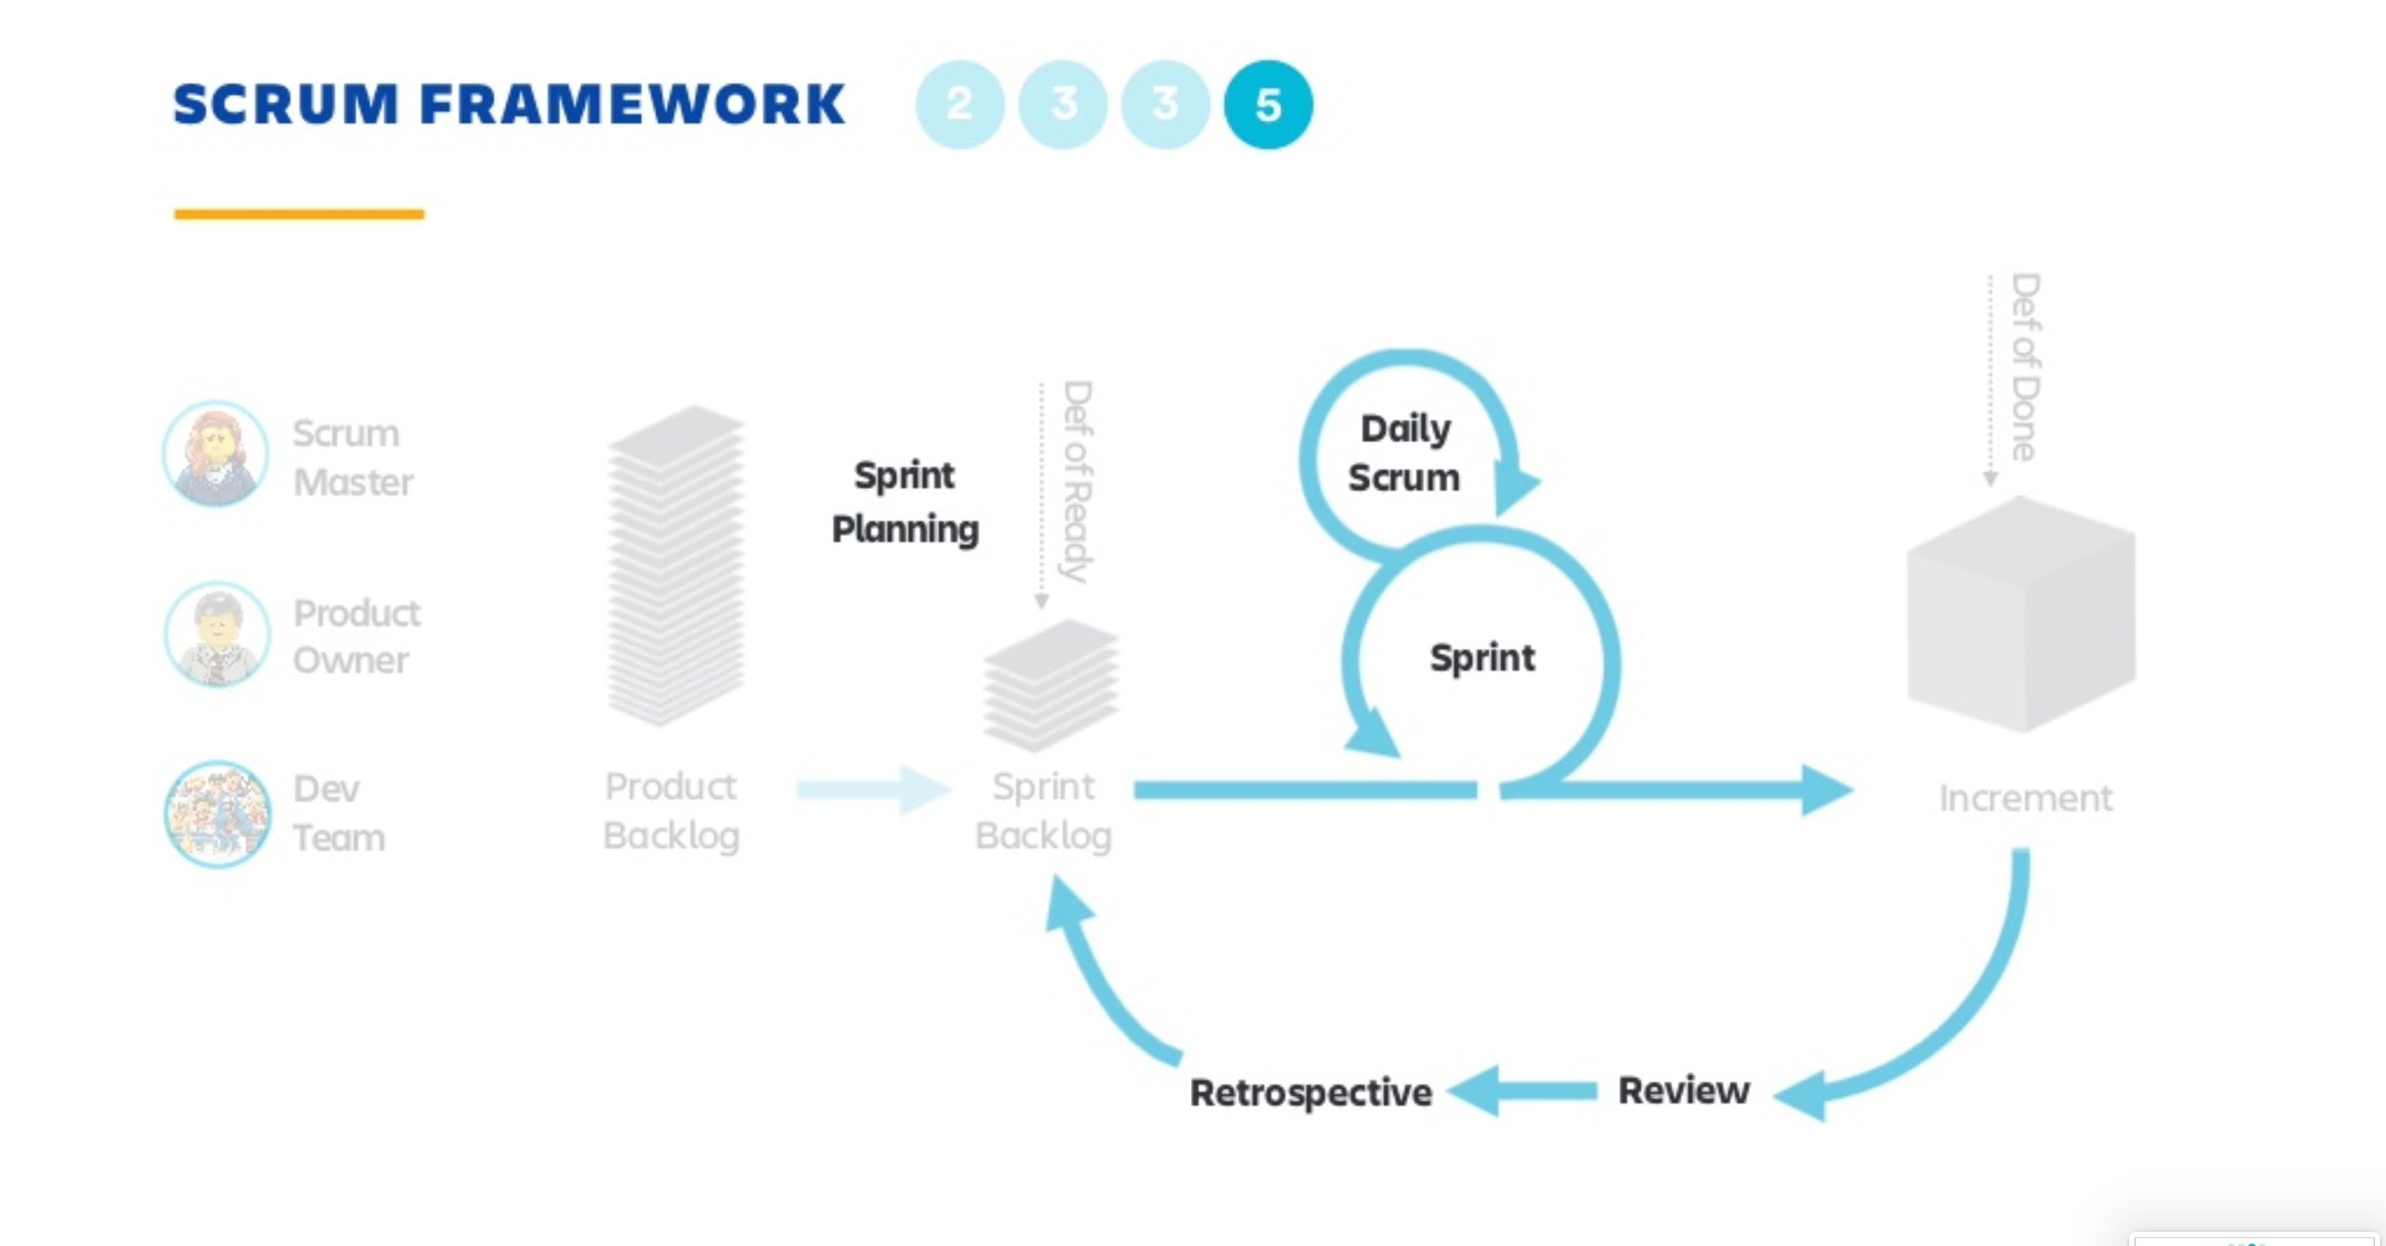

Slide 29
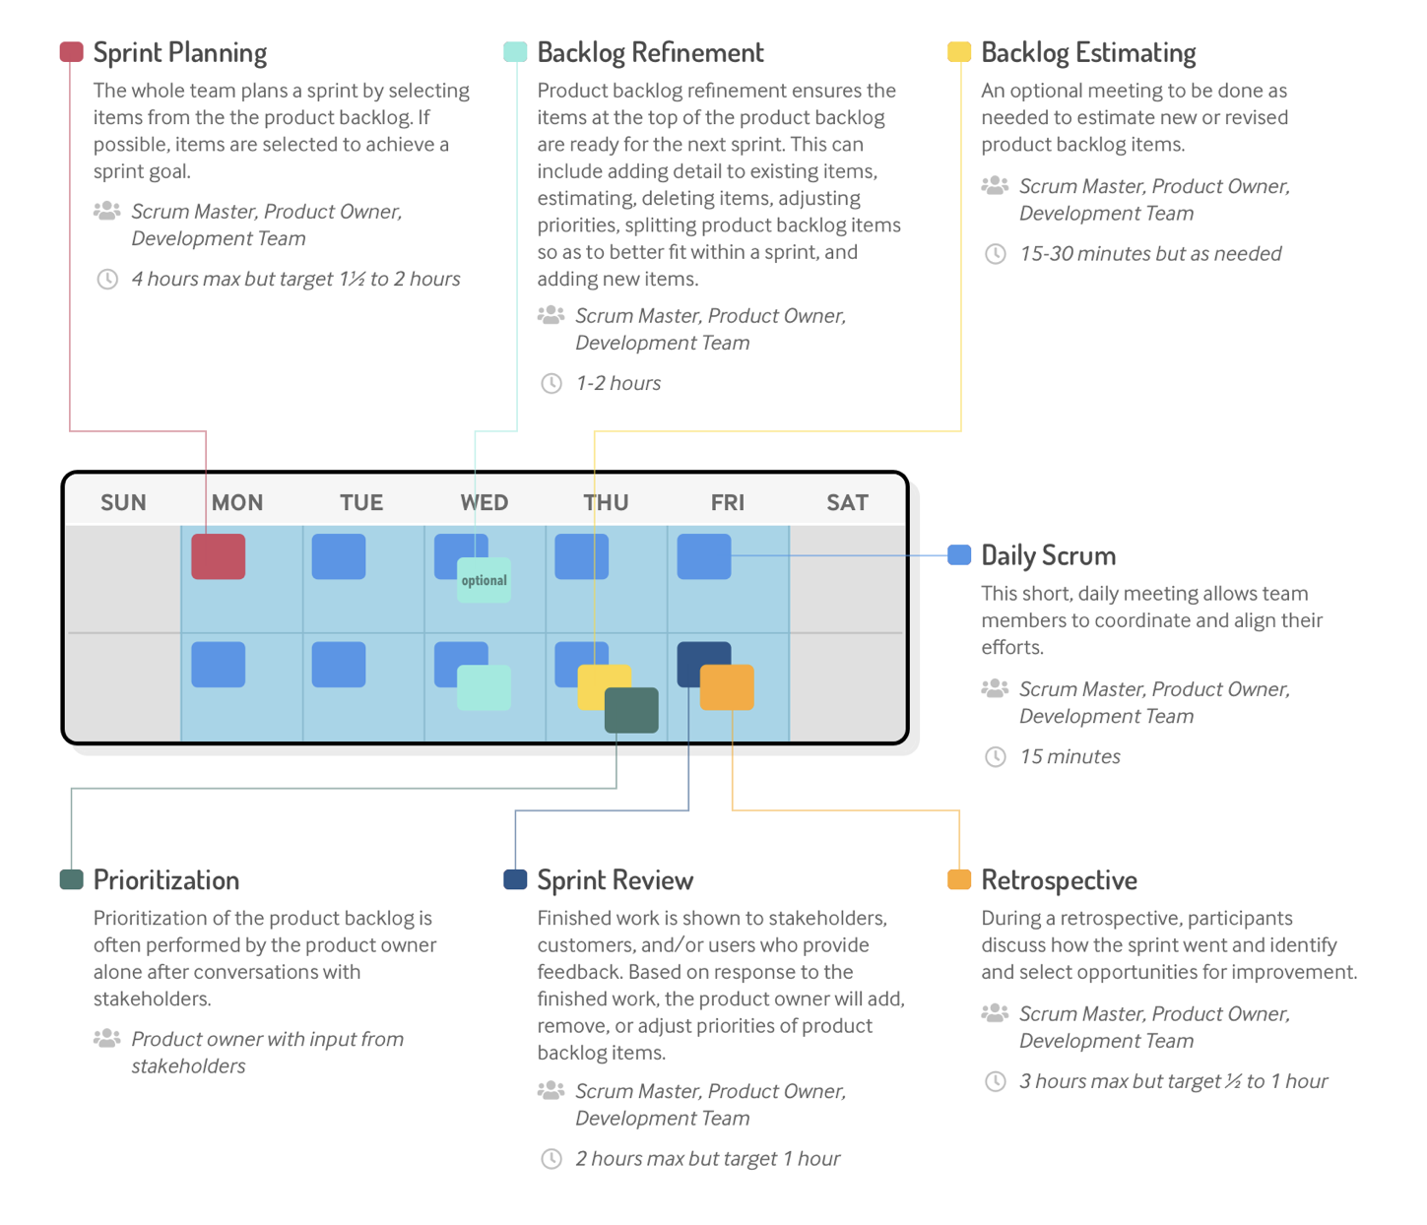
Scrum Events
Scrum Ceremonies Cheat Sheet.pdf

Slide 30
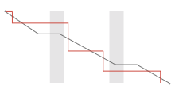

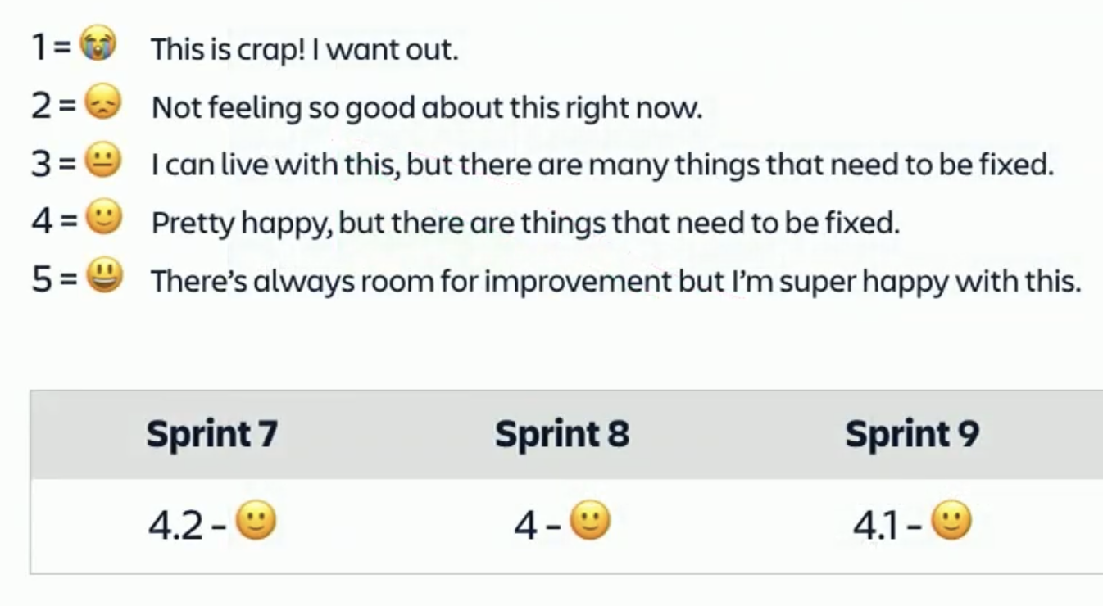


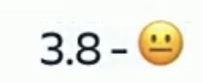


Sprint Results Metrics
Sprint burndown
Sprint velocity
Scope change
Sprint Review
- What did we build?
Sprint Retrospective
What did we learn?
Team sentiment

Slide 31
Backlog Grooming / Backlog Refinement
HIDDEN SLIDE
Description
Review, elaboration, estimation and prioritization of Program/Release (EPICs) Backlog items
People
Product Management — Defines/elaborates business features and acceptance criteria, prioritizes and identifies business requirements
System Architect — Provides technical context, defines/elaborates architectural features, identifies technical specs, and facilitates estimations
Product Owners and subject matter experts — Provide domain expertise
Frequency
Done at least one occurrence each Sprint , Recommended timebox: 1.5 to 2 hrs
Success Guidelines
Reviewing and updating backlog item definition and developing acceptance criteria .
Working with the teams to establish technical feasibility and scope estimates
Analyzing ways to split backlog items into smaller chunks of incremental value
Stories should follow INVEST principle
Identifying the enablers required to support new features and capabilities, and establishing their capacity allocation
INVEST
I – Independent N – Negotiable V – Valuable E – Estimable S – Small T – Testable

Slide 32
Release Planning

Slide 33


Release Cadence (DBX)
Prioritized Backlog / Estimation (story points) / Capacity based on Velocity / “Bug Jail” gates
quarterly
monthly
2 weeks
Hardening
Hardening & Planning
Hardening & Planning
4.3 Release
4.4 Release
4.2.3 Fix Pack
4.2.4 Fix Pack
4.3.1 Fix Pack
4.3.2. Fix Pack
Internal Engineering
Schedule
Sprint 1 Sprint 2 Sprint 3 Sprint 4 Sprint 5 Sprint 6
Sprint 1 Sprint 2 Sprint 3 Sprint 4 Sprint 5 Sprint 6
(June 3 – 14) (June 17- 28) (July 1 - 12) (July 15 – 26) (July 29 - Aug 9) (Aug 12 - 23)
Functional, tested sprints / Quality released often / Features released when ready

Slide 34
JIRA “Agile is a growth mindset. It’s a way of working grounded in a culture of learning.”

Slide 35
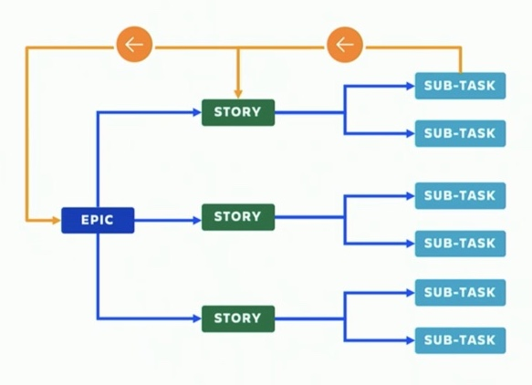
HIDDEN SLIDE
Typical JIRA Structure
Epics
Scoped to a Release
Components reference Projects
Estimation continually refined
Story
Breakdown to scope = one sprint
Estimation continually refined
Sub-Task
Breakdown to scope = one dev

Slide 36
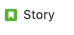
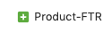
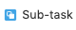

Current Kony JIRA Config (example: DBX)
HIDDEN SLIDE
Program - ADP
KEY | PROJECT | COMPONENT
ADP | Digital Banking Common | Retail Banking PA-DSS Onboarding Miscellaneous Engage DBX Integration Digital Banking Platform DBX Implementation | Customer 360 Consumer Lending Business Banking Apps Integration Apps Architecture App Fit
JDPAL | JDP App Loans | Customer 360 Consumer Lending
Project - AAC
Project - ARB
KEY | PROJECT | COMPONENT
AAC | Customer 360 | Online Banking Mobile Banking | Customer 360 Consumer Lending
ADBL | Apps Consumer Lending |  | Customer 360 Consumer Lending
AARC | Apps Architecture | Online Banking Mobile Banking Digital Banking Platform | Customer 360 Apps Architecture
ARB | Apps Retail Banking | RB Tablet Online Banking Mobile Banking | Customer 360 Digital Banking Platform
AOLB | Online Banking | Online Banking
ANUO | DBX Onboarding | Onboarding
ADBP | Digital Banking Platform | Online Banking Digital Banking Platform
APPINT | Integration | Integration
ARBT | Retail Banking Tablet | RB Tablet
DBB | Business Banking | Business Banking
AAF | App Fit | AppFit
AUX* | Apps UX/UI | RB Tablet Online Banking Onboarding Mobile Banking DBX Implementation | Customer 360 Consumer Lending Business Banking AppFit
JDP_ORNL* | JDP App Loans |  | Customer 360 Consumer Lending

Slide 37

HIDDEN SLIDE
Current Kony JIRA Config(example: DBX)
External – JDP-TDCU
Program - DBX
Program - JPD
External – JDP-ORNL
Project – Customer 360
Project - Docs
Project – Business Banking
Project – Online Banking
Project – Retail Banking
Project – UI/UX
[← clone]
Salesforce – Kony Support
Support Ticket

Slide 38
Principles: Enforce consistency; Empower teams to optimize
HIDDEN SLIDE
Semantics
Common schema and workflows within a product
Initiative, Epic, Story, Task, Defect, Support Ticket
Releases & Sprints
Common cadence across a product
Leverage Validators & Post Functions to ensure consistency, remove manual steps
Scoping
Common sizing and estimation at Portfolio and Program levels
Feature teams can define story points method, so long as consistent over sprints
Screens
Constant optimization based on feedback from teams
Limit required fields and manual steps
Automate ideal path, reports will reveal exceptions easily fixed manually
Teams Self-Serve
Customizable Dashboards and Filtered views

Slide 39
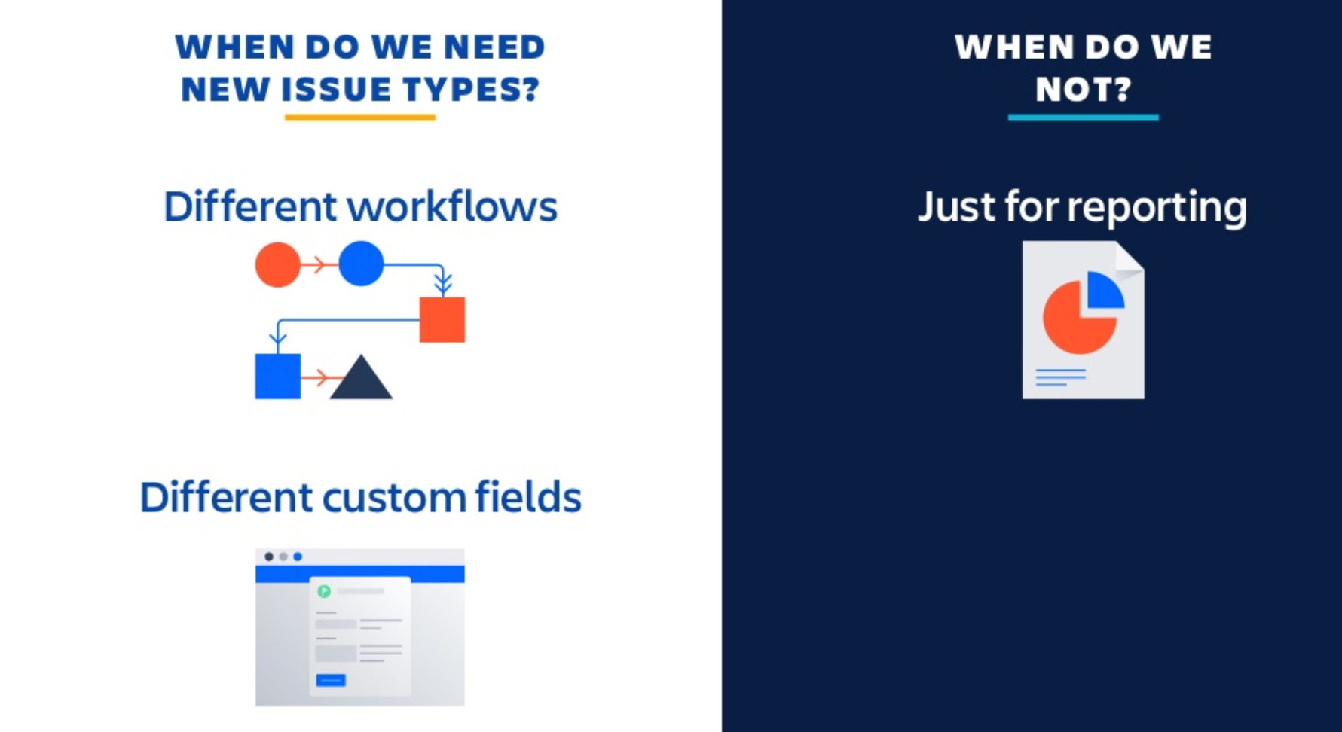
HIDDEN SLIDE

Slide 40
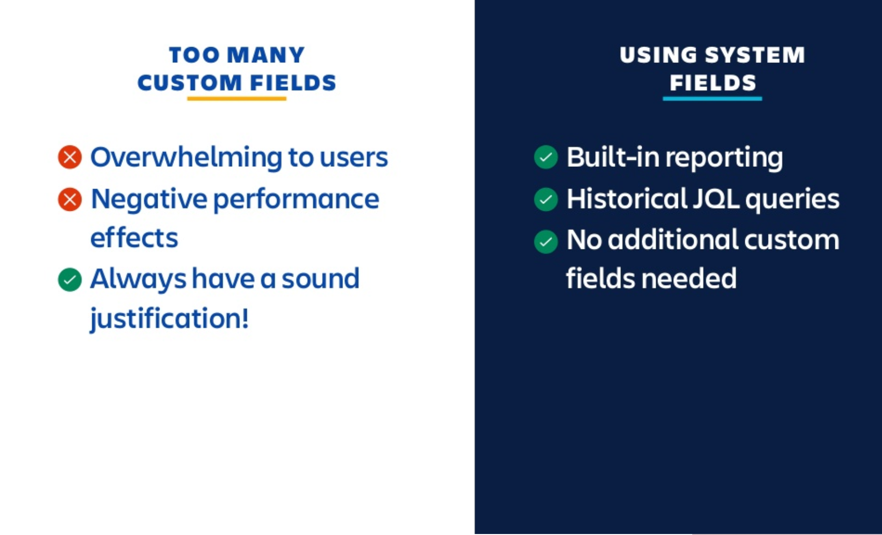
HIDDEN SLIDE

Slide 41
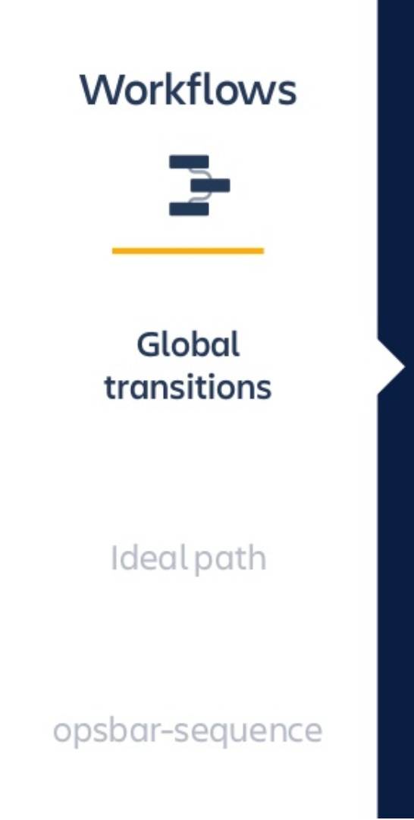
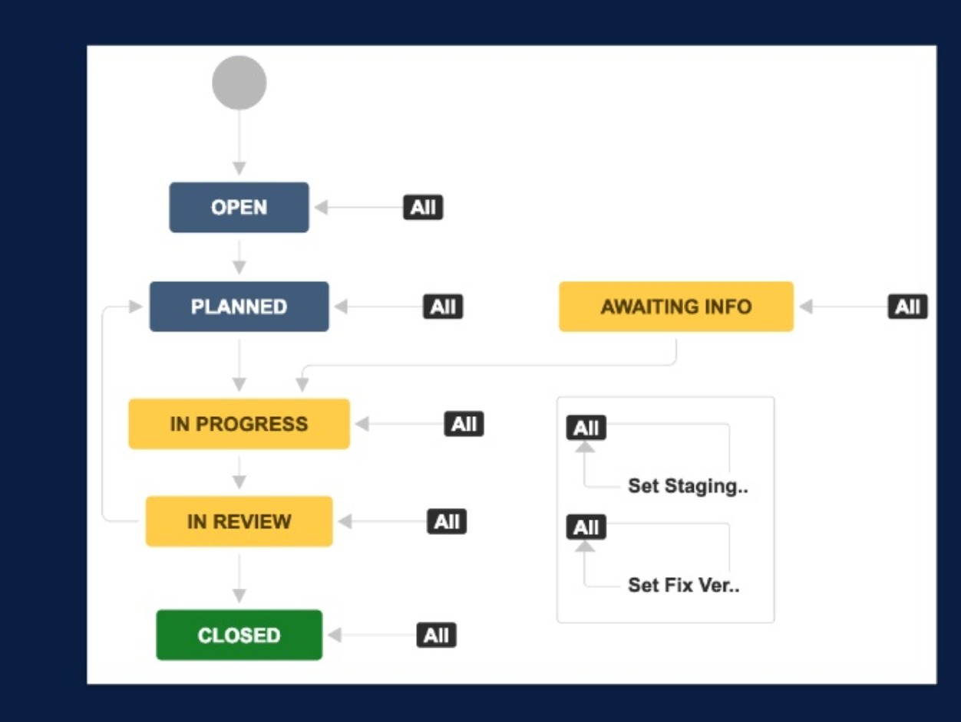
HIDDEN SLIDE
Global Transitions
Ideal Path
Automated
Link & Sync

Slide 42
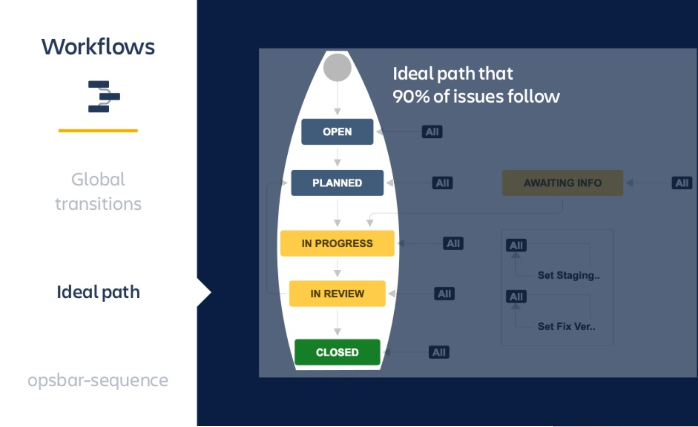
HIDDEN SLIDE
Global Transitions
Ideal Path
Automated
Link & Sync

Slide 43
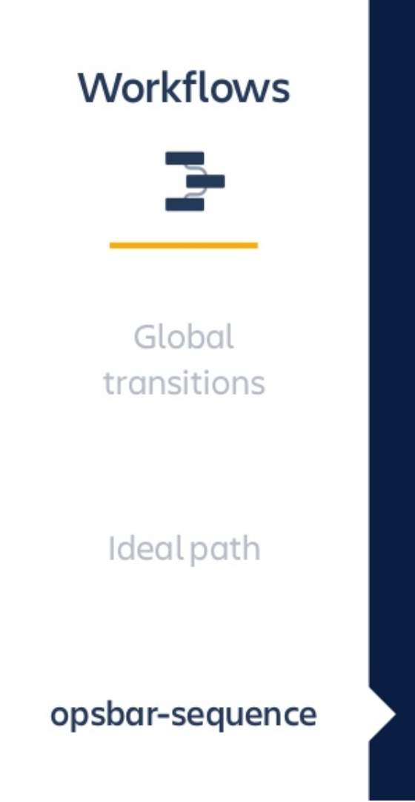
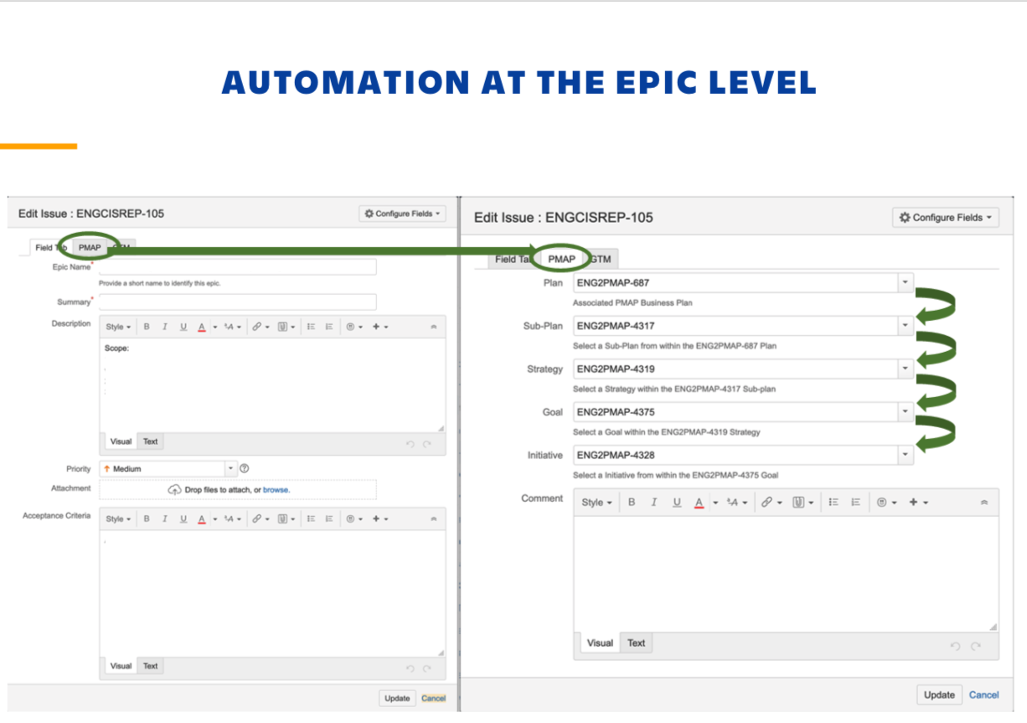
HIDDEN SLIDE
Global Transitions
Ideal Path
Automated
Link & Sync

Slide 44
Breakdown Initiatives into Epics w/ Estimation (Product Backlog)
Portfolio
Initiative
Initiative
Initiative
Release 4.3
Release 4.4
Program
Epic [A]
Epic [A][B]
Epic [B][C]
Epic [C]
Epic [A]
Epic [B][C]
Epic [C]
Sprint 1
Sprint 2
Sprint 3
Sprint 4
Sprint 5
Sprint 6
Team
Component Team A
(HIP) Hardening & Planning
Component Team B
Component Team C

Slide 45
Breakdown Epics into Stories w/ Estimation (Sprint Backlog)
HIP
Portfolio
Initiative
Initiative
Release 4.3
Program
Epic [A]
Epic [A][B]
Epic [B][C]
Epic [C]
Backlog
Sprint 1
Sprint 2
Sprint 3
Sprint 4
Sprint 5
Sprint 6
Team
Component Team A
Story/Tasks
(HIP) Hardening & Planning
Story/Tasks
Story/Tasks
Story/Tasks
Component Team B
Story/Tasks
Story/Tasks
Story/Tasks
Component Team C
Story/Tasks
Story/Tasks
Story/Tasks

Slide 46
Sprint 1 Planning (Pull, Don’t Push, Work)
HIP
Portfolio
Initiative
Initiative
Release 4.3
Program
Epic [A]
Epic [A][B]
Epic [B][C]
Epic [C]
Backlog
Sprint 1
Sprint 2
Sprint 3
Sprint 4
Sprint 5
Sprint 6
Team
Component Team A
Story/Tasks
(HIP) Hardening & Planning
Story/Tasks
Story/Tasks
Story/Tasks
Component Team B
Story/Tasks
Story/Tasks
Story/Tasks
Component Team C
Story/Tasks
Story/Tasks
Story/Tasks

Slide 47
Sprint 2 Planning (Inspect and Adapt)
HIP
Portfolio
Initiative
Initiative
Release 4.3
Program
Epic [A]
Epic [A][B]
Epic [B][C]
Epic [C]
Backlog
Sprint 1
Sprint 2
Sprint 3
Sprint 4
Sprint 5
Sprint 6
Team
Component Team A
Story/Tasks
(HIP) Hardening & Planning
☑️
Story/Tasks
Story/Tasks
Story/Tasks
Story/Tasks
Component Team B
Story/Tasks
☑️
Story/Tasks
☑️
Story/Tasks
Component Team C
Story/Tasks
☑️
Story/Tasks
☑️
Story/Tasks

Slide 48
Dashboards (and View) using Filters
Any inconsistencies are magnified. But because we can find then, we can also fix them
Whenever possible meetings and status communications should be dashboard driven
Everyone should understand how to author Basic and JQL Filters
Single “View of Truth“ via common Product-level Dashboards
Non-Feature Dashboard
Feature Dashboard
Defects Dashboard
Team empowered (and encouraged) to configure their own Dashboards
Confluence has rich Dashboard capabilities including Jira reports and issue filter views
Don’t forget to set Filter Permissions when configuring Filters for Dashboards

Slide 49
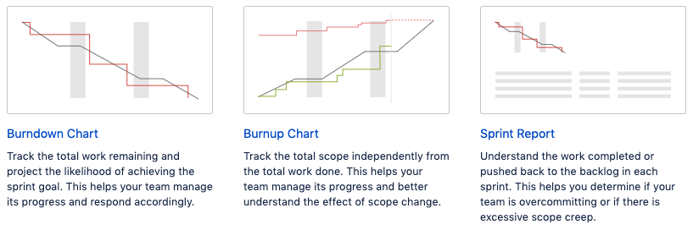
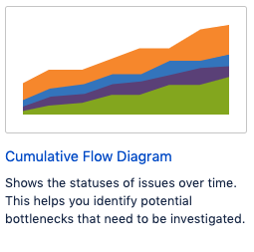
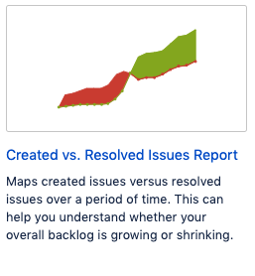
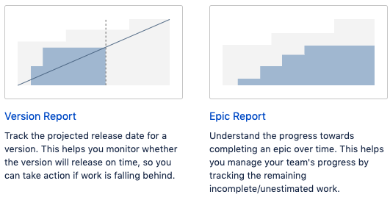
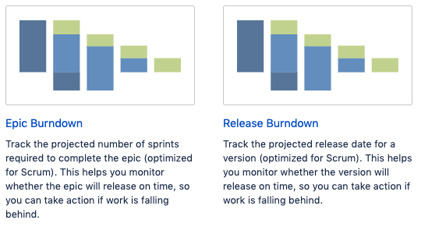
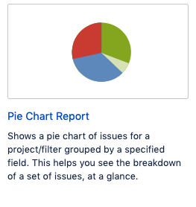
Jira Built-in Reports

Slide 50
Quality
“You only evaluate a product once.”

Slide 51


Pyramid of Testing
Non-functional Catalog
(driven by business and design)
Performance and capacity
Security
Reliability
Recovery
Operability
Browser/OS Compatibility
Backward Compatibility
Installation
Availability
Accessibility
Compliance
Internationalization
Cognitive Walkthroughs
Usability
UI / UX - Indexing
Visual QA
Business Facing
User Acceptance
Testing
Customer/User Journeys( to include upgrade support)
Exploratory Testing
Integration/Upgrade Testing
[ Z %]
Coding standards/Checklists/Reviews
Design Docs/DFD/ Arch docs
Code coverage
Dynamic and Static analysis
Stubs and Mocks
Tech specs/ API Specifications/Contracts
API Testing
[ Y %]
Technology Facing
Unit Testing
[ X %]
Internal – 'Escape Defects' Trend

Slide 52
User Experience
HIDDEN SLIDE
NFR Catalog & Quality Gates
Information Architecture
Wireframes
UI/UX Design
Interaction Design
UI Development
Application testing
Visual Design
QA (User Testing)
SketchFlow
QA
Mind maps
Visual QA
Product Backlog
Initiatives, Themes
Epics, Stories
Non-Functional
Requirements
output
Q Gate
Q Gate
Q Gate
Q Gate
Enterprise Architecture
Strategy
Solution Design
Implementation
Platform development
Application testing
Design standards and QA
Unit Testing
API/Integration
Static Code
CI/CD enabled
Structure
Purpose
Practice
Standards and QA
Engineering Excellence

Slide 53
Quality Gates
Sprint(s)
All planned US complete
Milestone(s)
Feature complete
Documentation Complete
Release
All Planned Epics Signed Off and Delivered
Code Review
Design Review(if applicable)
Unit Testing Complete
API/Integration/Service tests complete
UAT complete
Showcase approved
Deign Review complete
UI/UX index(s) – Pass
Security Index(s) – Pass
UAT complete
BAT Complete
UAT Complete
Documentation Complete
BAT Complete
Known Open Defects/Risks - Approved
Demo SetUp Complete
Security Testing Complete
Performance and Capacity testing complete
Performance Testing complete

Slide 54
Quality Gate RAG Report
Version: 9.3.8 – 12th Nov
Parameters | Details | RAG Status | Comments | ETA
Features | List of Features
Bugs | List of Bugs
Regression Testing Report | Regression cases covered + bug reported |  | Couple of issues are not fixed – impact? | When all regression issues will be fixed
Validation of solution teams (based on staging automation) | Any breaking bugs
Security Testing | Scan report + fix status
Performance testing
Solutions/PS team sign-off
Documentation + Release notes
Detailed Sign-off Report with artifacts:

Slide 55
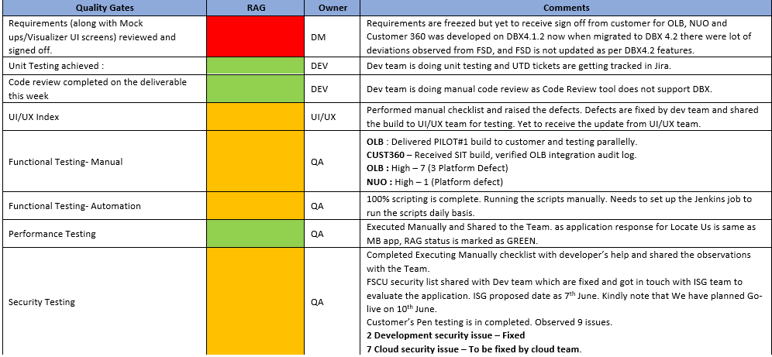
Quality Report

Slide 56
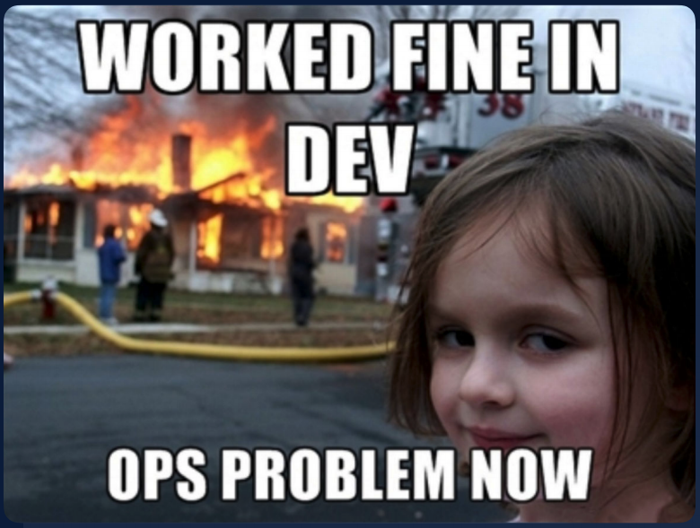

Slide 57
DevOps “Continuous Integration doesn’t get rid of bugs, but it does make them dramatically easier to find and remove.“ - Martin Fowler, Chief Scientist, ThoughtWorks

Slide 58

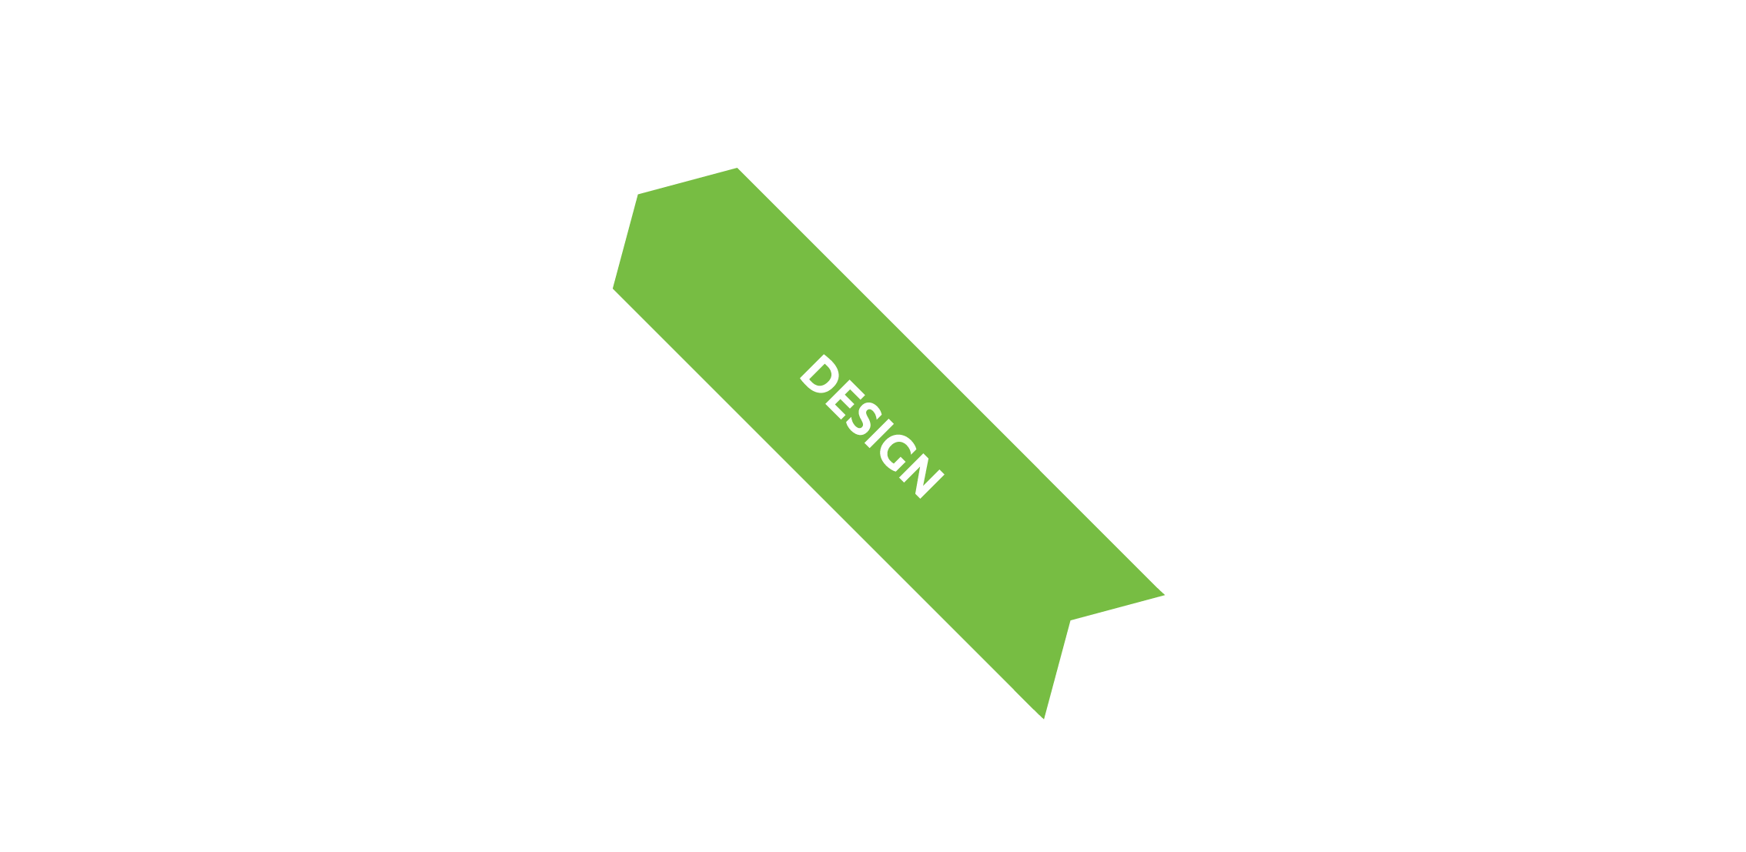



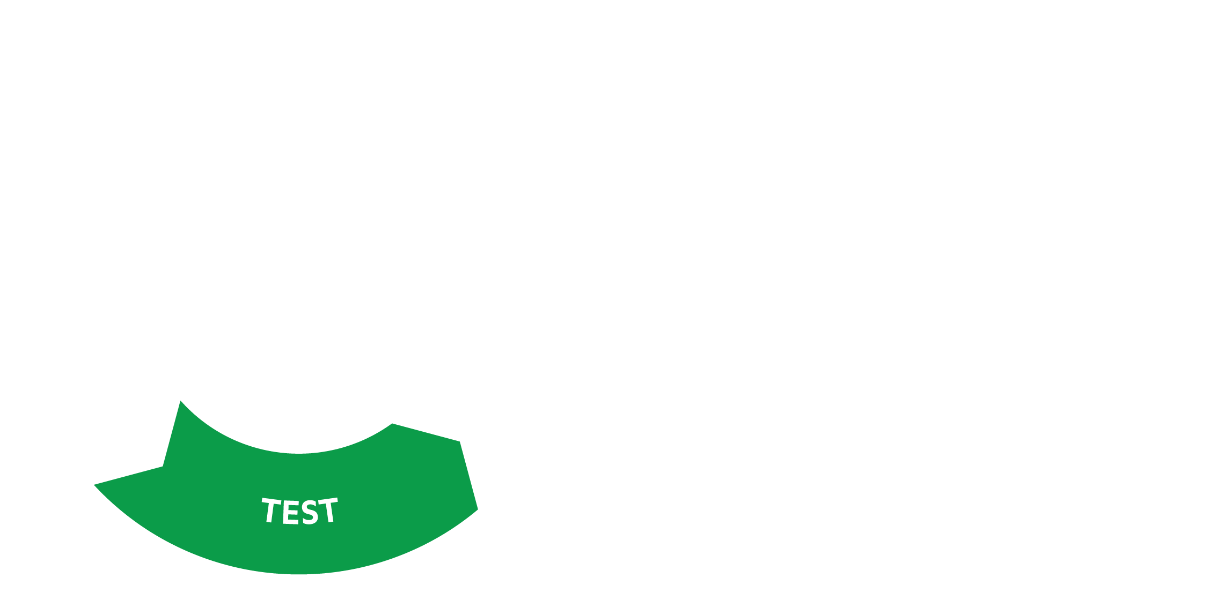
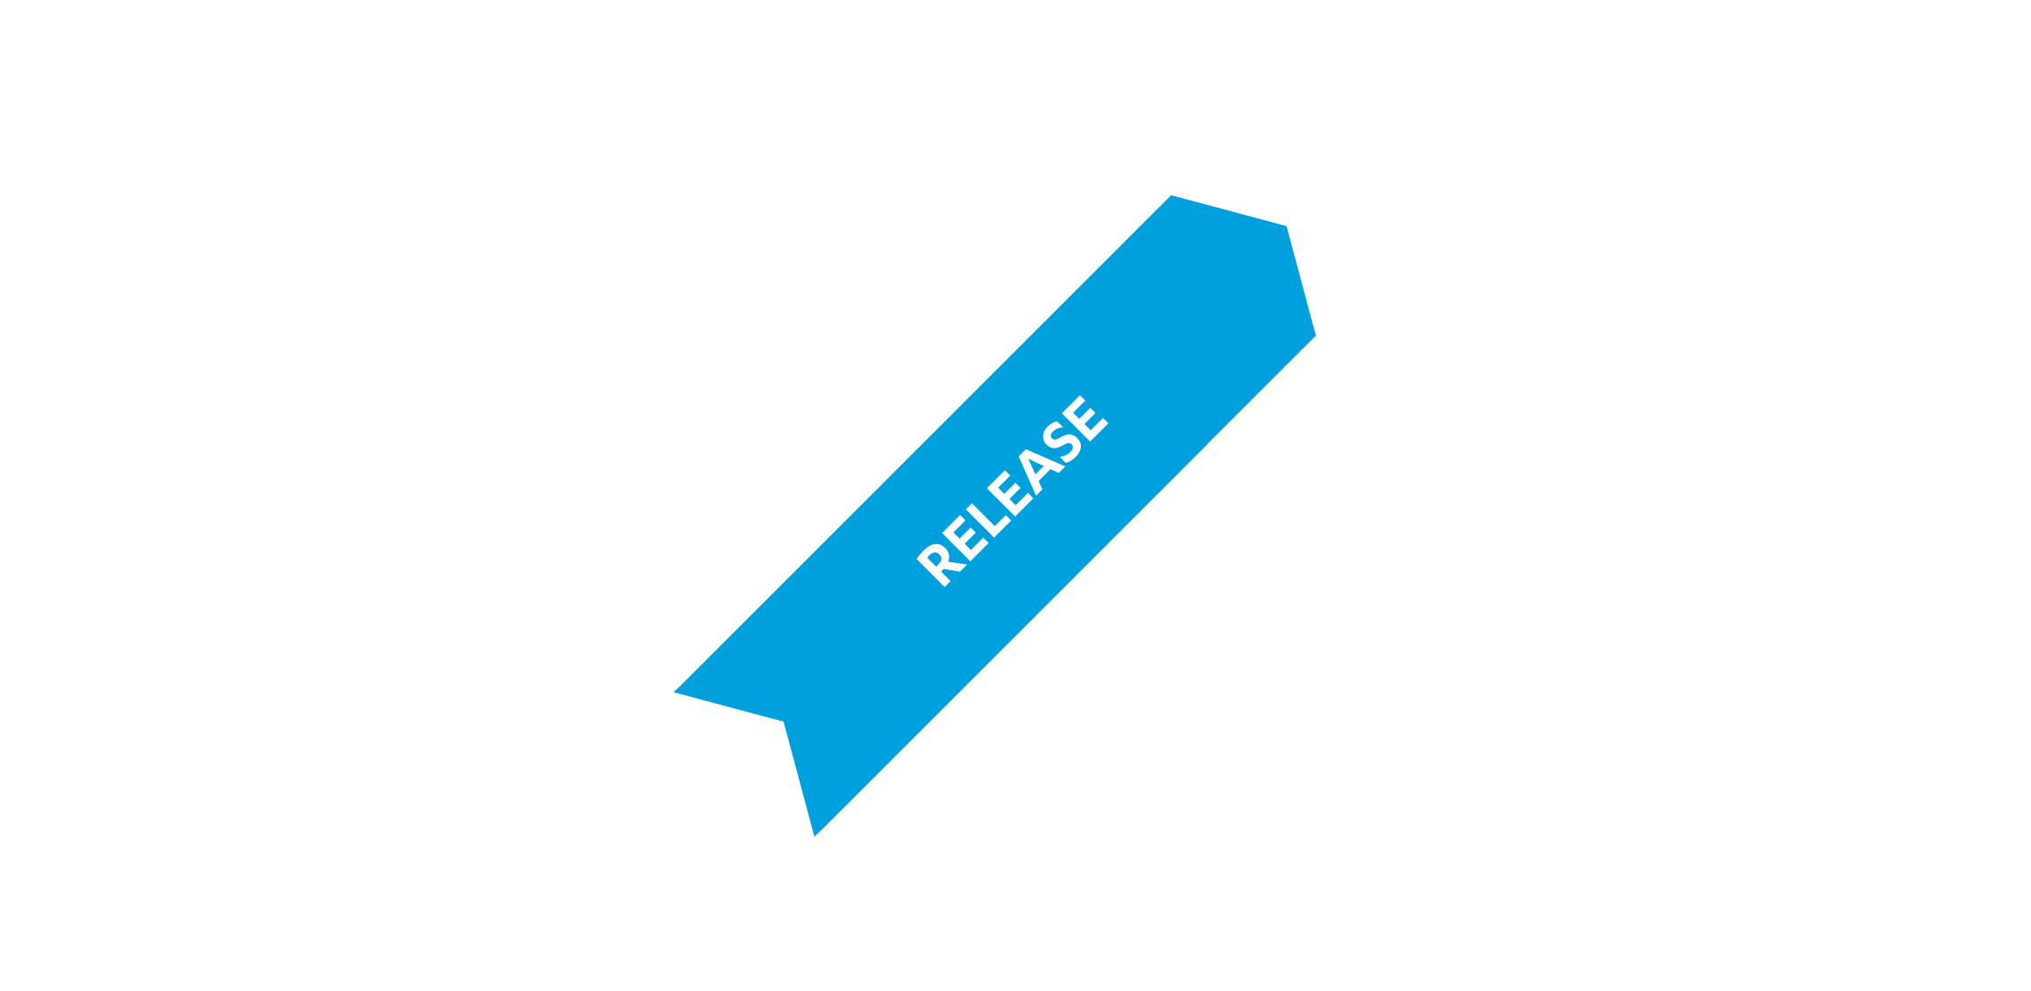



DevOps
App Stores
API Management
Dev Tools
Front End
Design Tools
Marketplace
MAM,MDM
CI/CD Tooling
API Management
Web Testing
Device Testing
Logging
APM

Slide 59

Every Build Follows an Automatable Process
HIDDEN SLIDE
Developers check their code into the source repository
Developers request a build or the build manager wants to perform a daily build.
The build manager pulls the code from the source repository to his local machine.
The Build manager manually builds each channel.
The Build manager manually moves the build artifacts to a storage location.
The Build manager emails the links or binaries to the developers
Build manager sets times in each day to manually build binaries
If there is a problem he has to send an email to the developers.
Build manager manually manages the curation of build artifacts
Build manager manually manages the curation of build artifacts
Speedbumps
Notes:
The Build manager is the gatekeeper of your app in most cases. The build manager performs code review, merges and kicks off every build. The problem here is that a build manager is the builder. Each time a person commits code without building it first, there is a likely hood that they are pushing in code that doesn’t work. The more code that gets submitted without building, the more likely there are one or more bugs introduced into the application. The problem is then finding this error through piles of code. If you build every time code is committed, the build manager can focus on higher level problems and more builds means less time taken finding problems.

Slide 60
Testing Automation Ensures a Baseline
HIDDEN SLIDE
Handling Repetitive Tasks - If your team wants to ensure a base of features is executed every time a build is completed.
Eliminate Human Error – Automated test are powered by tools and scripts and are more reliable and tie efficient than using manual testing
Test Across More Devices – Leverage tools that enable you to test across multiple devices reducing the resources needed to ensure your app runs across different platforms and OS versions.
Test 24/7 – Test any time you build
Notes:
Just like automating a build, automating a baseline of tests helps to ensure that there is a minimum acceptance of testing before anyone even begins manual testing,

Slide 61
Build Frequency and Benefits of Build Automation
Build and Test Frequency
Waterfall
Agile
DevOps
Benefits of Build Automation:
Shorter build cycles and build time
Find Bugs faster
Get features to market faster
Provide feedback sooner
Easily roll back changes
Build now, build often
Repeatable
Notes:
This is represented in this simple slide. The top represents the length of time people normally commit to building a project typicalle once a week.
When people started doing agile development, building became more frequent, but it’s likely its dedicated resources to more builds
Build automation makes building easier and therefore more frequent providing the benefit of finding bugs faster, easily rolling back changes and creating a repeatable process for building apps

Slide 62
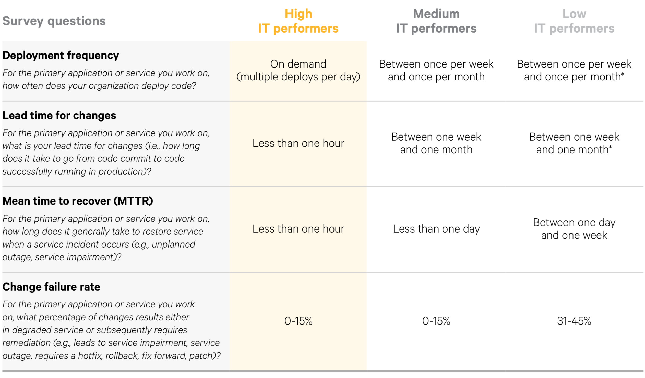
Benefits of Automation
HIDDEN SLIDE
The more frequently you can deploy, the lower the change failure rate
Source –State of Devops report 2017
Notes:
This means that projects have lower change failure rates and can mage change in a project with more agiily. This is where the build automation service comes in.

Slide 63
Build automation made simple
Build and Execute
Consistently build across channels including iOS mobile, Android mobile, iOS tablet, Android tablet and responsive web.
View Results
Maintain a history of past builds and distribute builds easily
Email results and binaries
Schedule a build
Build for specific times, manually kick off a build, or build every push to the branch

Slide 64
Testing as Part of Every build
Manage Devices
Create pools of devices to test your app across your channels.
Run Tests
Run native device testing and web testing as part of your build process
Email results test results
View Results
Maintain a history of past tests and test results.
Email results test results
Notes:
Read the slide

Slide 65










AppFactory CI, CD and Device Testing
Source Control
Build Automation
Testing
AWS Device Farm
Email User
Email User
Continuous
Integration
Scheduler
Auto builds
Build Android
Build
Windows
Executed
Automated
Device Testing
(Device Farm)
App Store Deployment
Web App
Deployment
Build iOS
Build
Web Apps
User Checks in Project
Build
Complete
Deploy Back- end Service to Runtime
Test Complete
User logs into Build Console and executes a manual build
Build Desktop Executables
(ex. Kiosks)
PARALLEL PROCESS
Store Results
Store Results
Notes:
The Kony Build Automation service is part of the Kony AppFactory and one of our devOps services offered by Kony. Today, I am going to focus on the build service but you can see how it fits in our overall DevOPs service offering we call AppFactory. Lets take a quick look at the diagram. To walk through how the Build Automation service works.
A user checks their code into their git source repository
The use can automatically kick off a build based on a build schedule, build every time code is pushed to a branch or even build from the manually from the Build Automation console.
Once the build is complete, the user receives an email witt OTA links to the binaries they created. The can also log into the KonyFabric console and view a history of their builds for the project.
Although its not part of the Build Automation service, we can additionll include automated testing on real devices via Appium scripts and the AWS device Farm. When this is complete we can view the results in our console as well as review our email. Lets take a look at the key features of the Build Automation service

Slide 66
GitHub
Jenkins
AWS Device Farm
Airwatch
Source Control
Continuous Delivery
Automated Testing
MAM,MDM
Logging Service
AppStore
AppPreview
Crash Analytics
Managed App Monitoring
DevOps Services
Private Marketplace
AppPlatform
Notes:
When we set up our App Factory offering for a customer, we follow 5 main steps.
Define – We define clear success criteria by looking at the customer’s strategy, the scope of the initial project, the success factors we’ll measure and how we’ll integrate with their Global or Enterprise architecture.
Align – We compare our proposed teams or people, processes and technology with the customer’s current environment and culture to ensure we are aligned for success
Implement – We then tailor the app factory architecture if needed and stand up the App Factory Runtime environment. We then build out the first application using the App Factory to demonstrate how it works. In some cases, we’ll build 2 or 3 apps in parallel if possible.
Operate – We then apply our go-live processes for deployment, monitoring and maintenance along with integration with our App Management and Analytics.
Harvest – Lastly, we go through a knowledge transfer phase, identify the assets that can be reused in future projects, and create any additional content or documentation required.

Slide 67
Implementation Plan

Slide 68
Scaled Agile Framework for Lean Enterprise (SAFe)
“a methodology and knowledge base of integrated principles, practices, and competencies for Lean, Agile, and DevOps designed and adapted for the needs of enterprise businesses”
IMPLEMENTATION PLAN
The Tipping Point
Build the Coalition
Define the Guiding Vision
- Agile Framework
Communicate and Begin Training
- Agile Training
Empower Teams
- Agile Tooling
- NFR Catalog & Quality Gates
Launch Agile Release Train
John Blanco — Enterprise Agile Transformation Leader
Extend to Portfolio
- Agile Product Management
Sustain and Improve
- DevOps & Continuous Delivery
- Metrics & Maturity Models

Slide 69
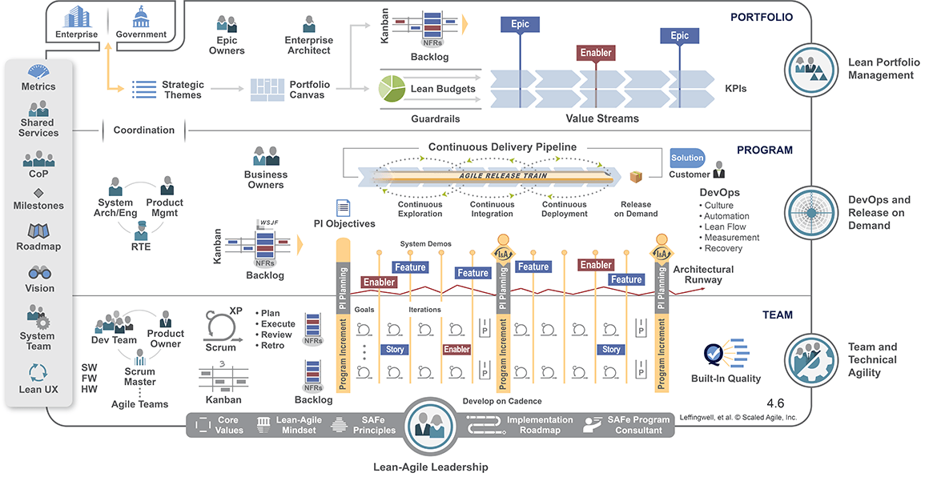
Scaled Agile Framework for Lean Enterprise (SAFe)
Plans informed by SAFe process definition, implementation guidance and training materials

Slide 70














“Fast Track” Agile Implementation Roadmap
Tailored and accelerated for Kony Product Engineering
The Tipping Point
ESTABLISH A SENSE OF URGENCY
Assess organization capabilities
Identify needs, risks and urgency
Build the Coalition
CHANGE AGENTS TO MAKE IT HAPPEN
Assemble working group
Establish PMO as Lean-Agile Center of Excellence (LACE)
Define the Guiding Vision
DESTINATION AND PATH TO GET THERE
Select, customize Agile framework
Define implementation plan and success metrics
Communicate and Begin Training
START BY ENABLING LEADERSHIP
Communicate vision and plan
Begin training:
- Implementing SAFe
- Leading SAFe
Empower Teams
ORGANIZE AND ENABLE TEAMS
Defined Processes & Configure Tools
Continue training
- SAFe for Product Owners
- SAFe for Scrum Masters
- SAFe for Teams
Launch
COACH, INSPECT & ADAPT
Facilitate and coach teams
on org-wide rollout
Inspect and Adapt each sprint and release
Manage as Portfolio
ALIGN BUSINESS AND ENGINEERING
Adopt Portfolio Management tools and processes
Align engineering investments and business portfolio objectives
Sustain and Improve
CONTINUOUS IMPROVEMENT
Invest in DevOps and
Continuous Delivery
Refine processes using
empirical data and learning

Slide 71
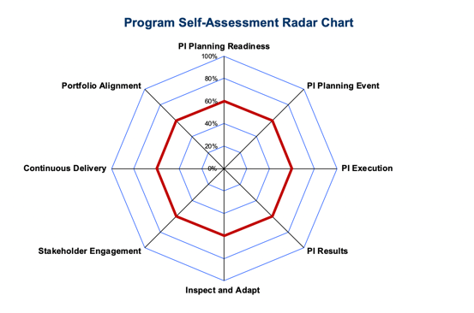

Metrics, Maturity Models & Review Cadence
Agile Transformation: Achievements
SAFe Essentials practices (Q1)
Test framework based on Quantum tools (Q1)
SAFe Full practices(H1)
Rhythm of Business – review cadence
Sprint and Release retrospectives
Product QBR
Crosslake Checkpoint (review on progress and plans)
Execution: Sprint/Release Metrics
Sprint and release burndown
Sprint velocity
Scope change
Team capacity
Capability: Maturity Model
Team Maturity
Product Group Maturity
Business: Product Scorecard
Escaped Defects ≤5
Meet/exceed Engineering productivity
Meet/exceed Opex AOP targets
20/20 Time-to-Value > 75%
NPS score (@ 6-9 months)
Free trial funnel –live apps > xx%
CSAT Score >=80%

Slide 72


Maturity Model details
The Agile Team Maturity Model is used by teams to baseline relative Agile maturity and then self-assess quarterly and/or after product releases to measure progress.
Maturity Assessment:
Team Self-Assessment
Program Self-Assessment
Lean Enterprise Assessment
DevOps Health Radar

Slide 73

Commit to Quality
“What leaders tolerate, they encourage”
COMMIT TO FIXING
“BROKEN WINDOWS”

